Slide 1


NSA GBM 9/8
We will begin shortly!

Slide 2

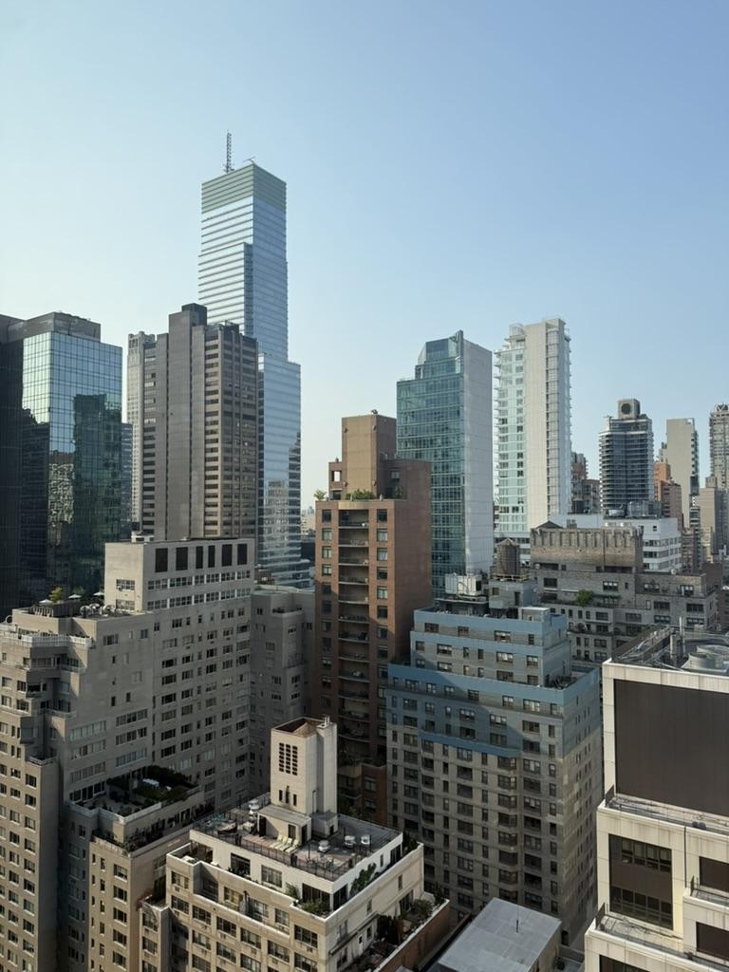
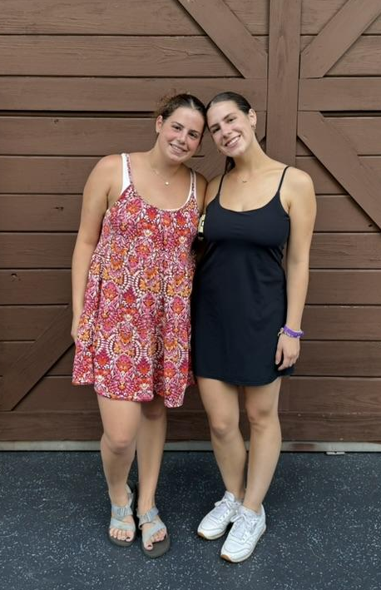
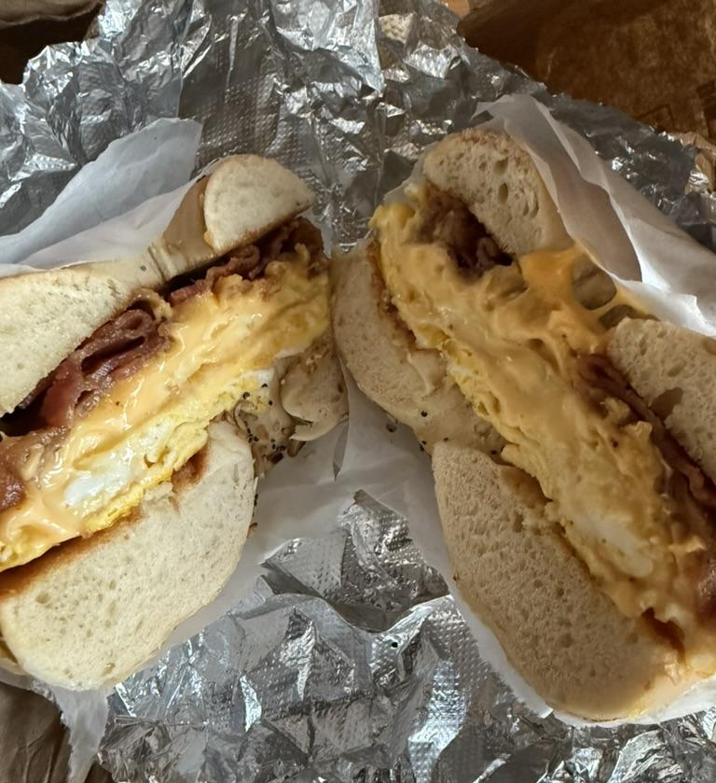

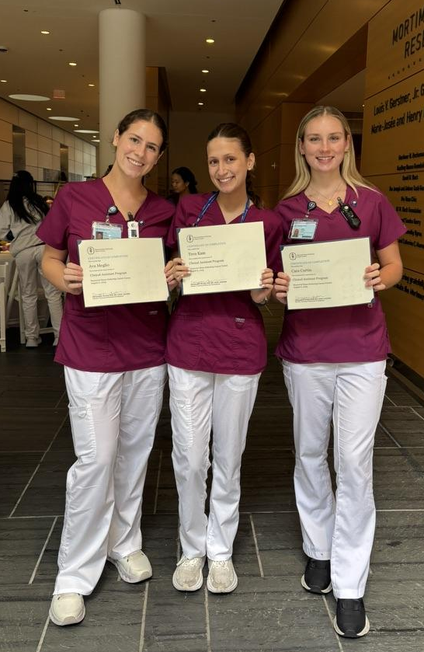

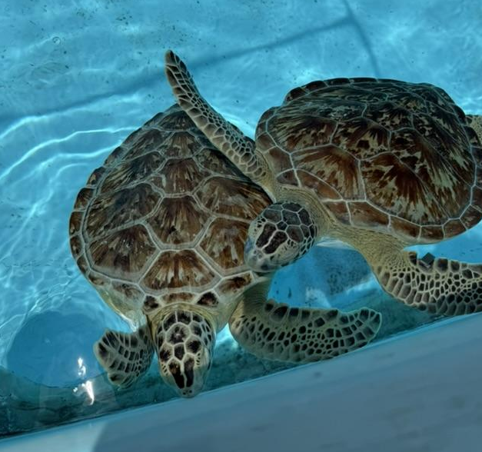
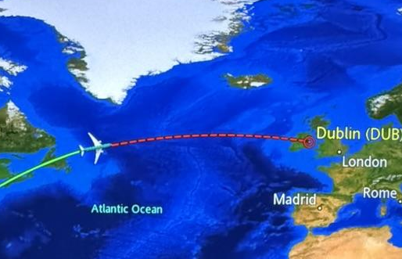
President: Ava Meglio - aim53@pitt.edu
Welcome to Pitt Nursing Student Association!!
About NSA →
  NSA is a constituent of both:
    the Student Nurses’ Association of PA (SNAP)
      Ann (Secretary) and Sophia (PD Chair) are on board/NEC
    the National Student Nurses Association (NSNA)
      Leah (VP) is on Nominations and Elections Committee
  Joining NSA…
    Leadership & Professional Development
    Scholarship Opportunities
    Networking & Community of Driven Nursing Students
    More!
About Me
Senior from Doylestown, PA
Love traveling, coffee, & trying new restaurants
Interned in NYC this summer & worked as camp counselor
Involved in URMP & studied abroad
Reach out with any questions :)
Notes:
Hi ava

Slide 3
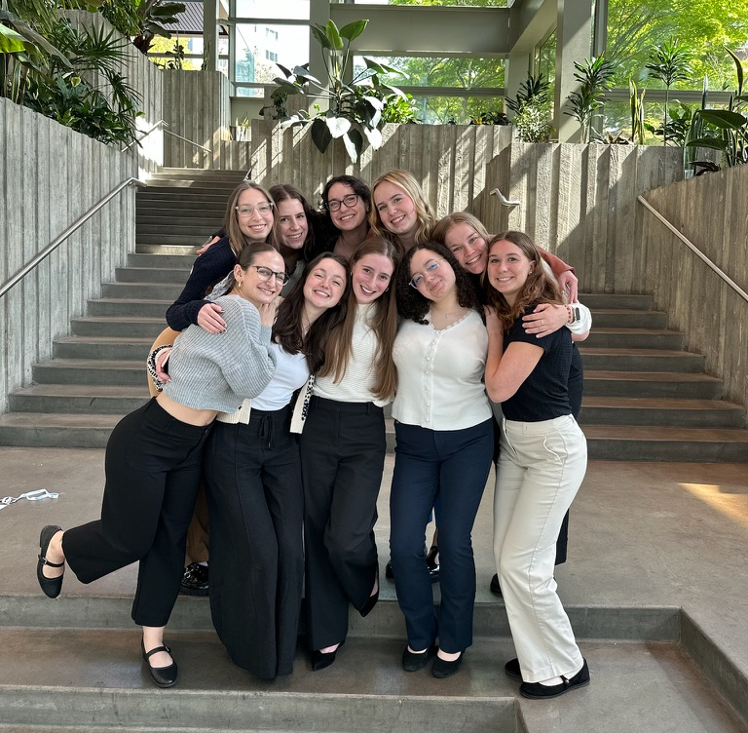
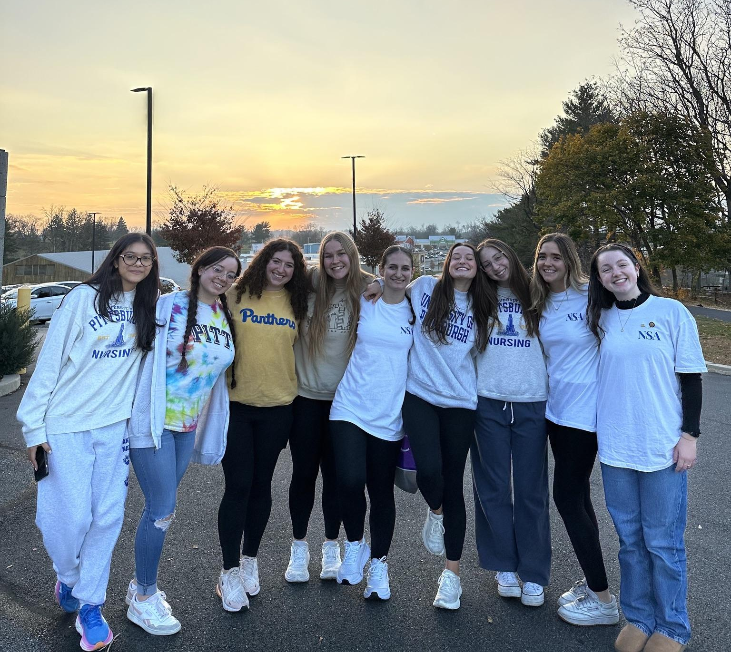
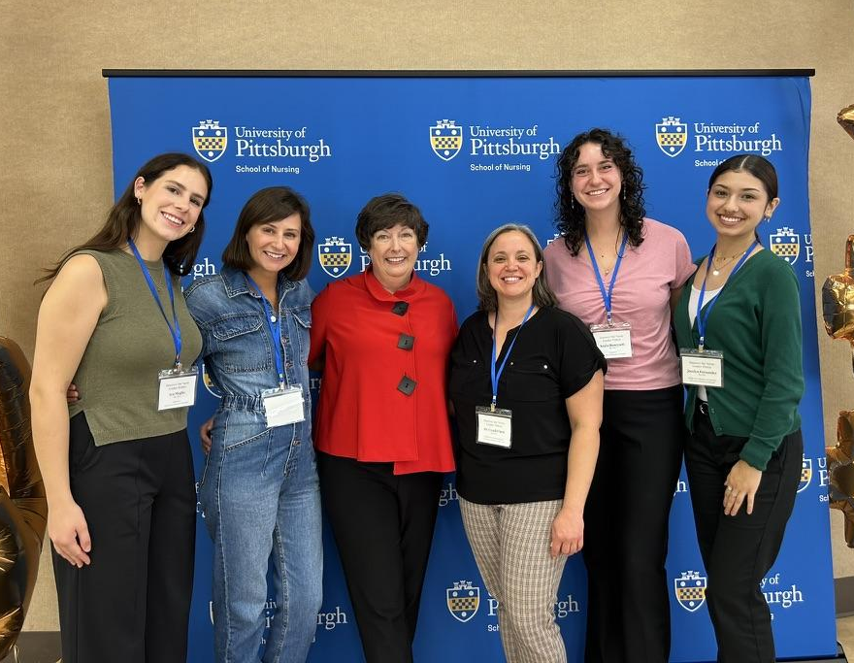
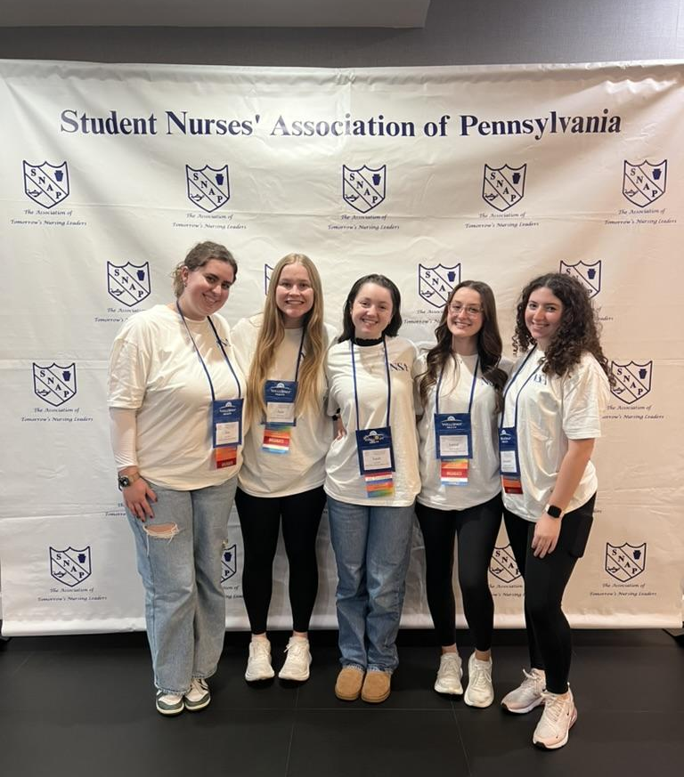
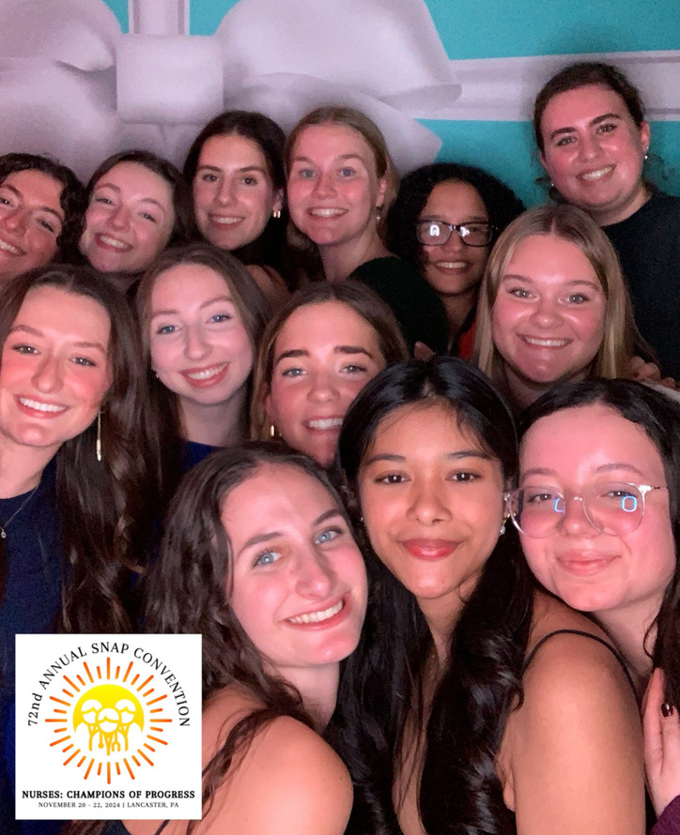
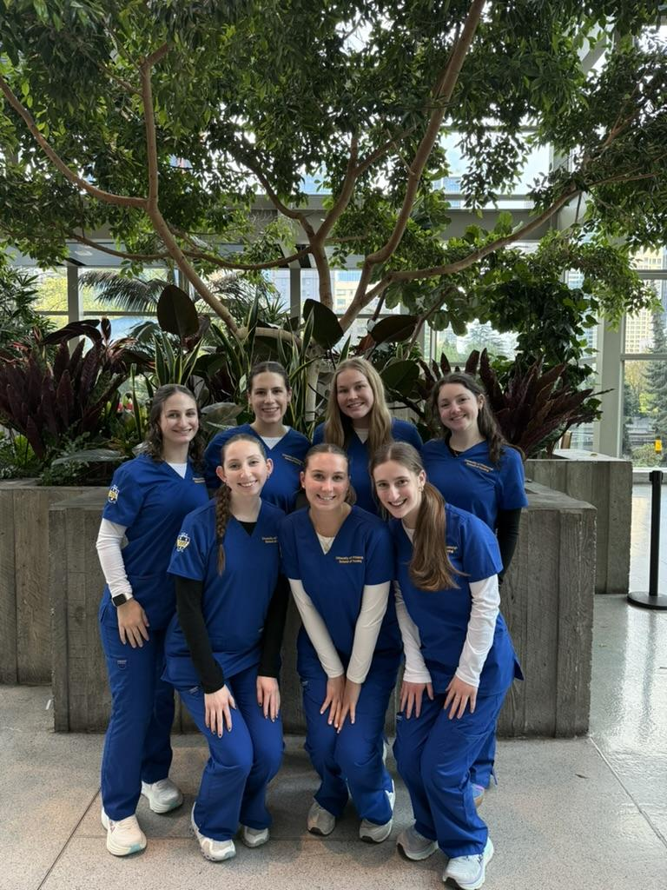
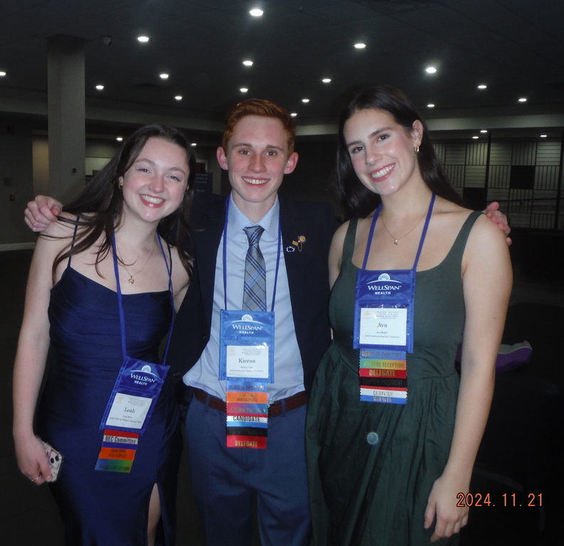
⭐️NSA 24-25⭐️

Slide 4
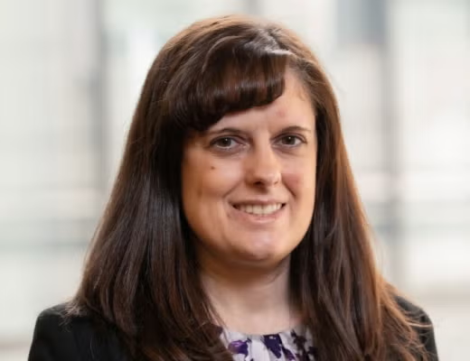
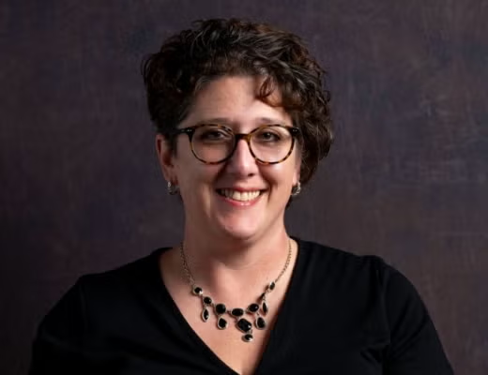
Our Faculty Advisors
Melissa Harlan
mdh71@pitt.edu
Tracy O’Brien
tao67@pitt.edu

Slide 5


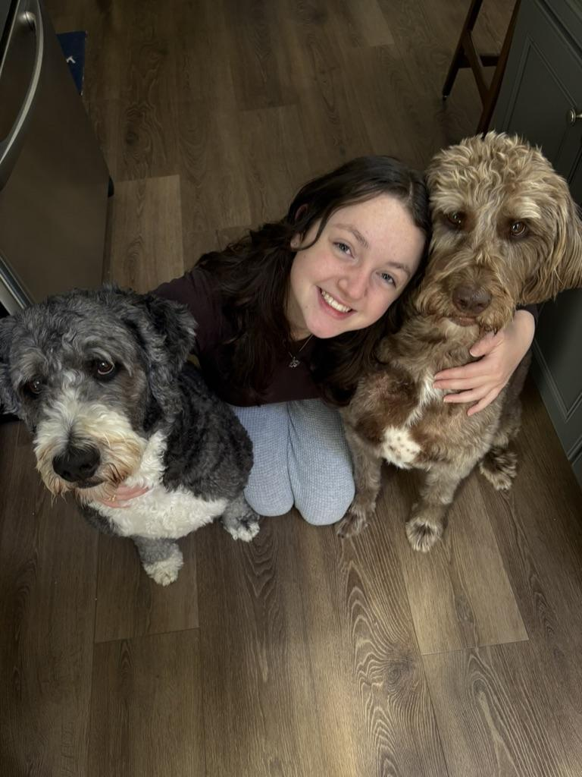
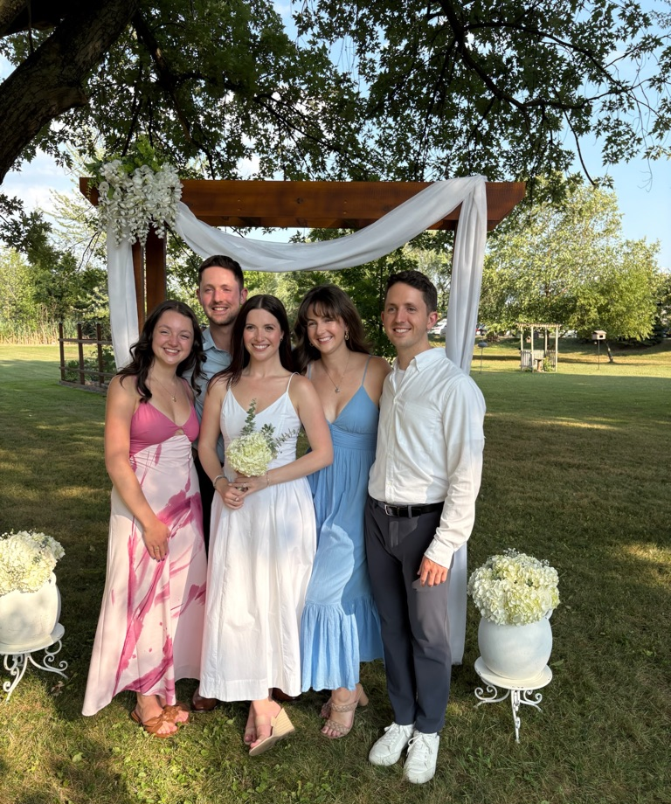
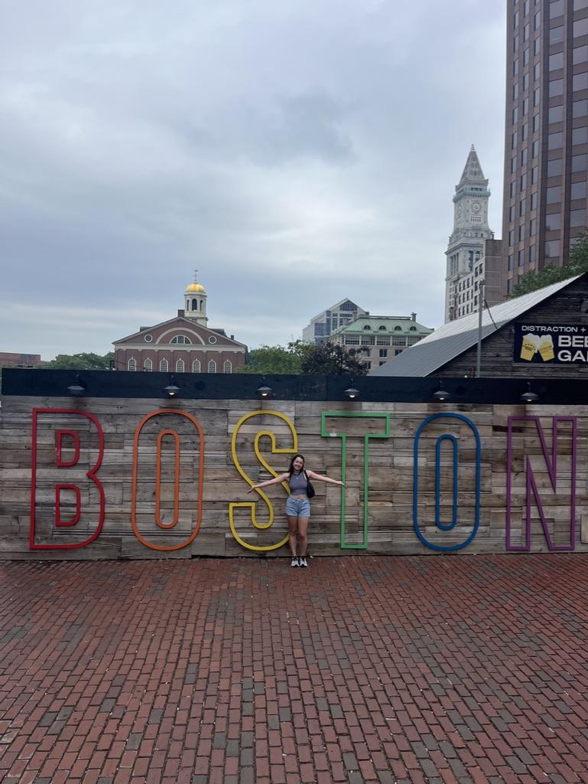
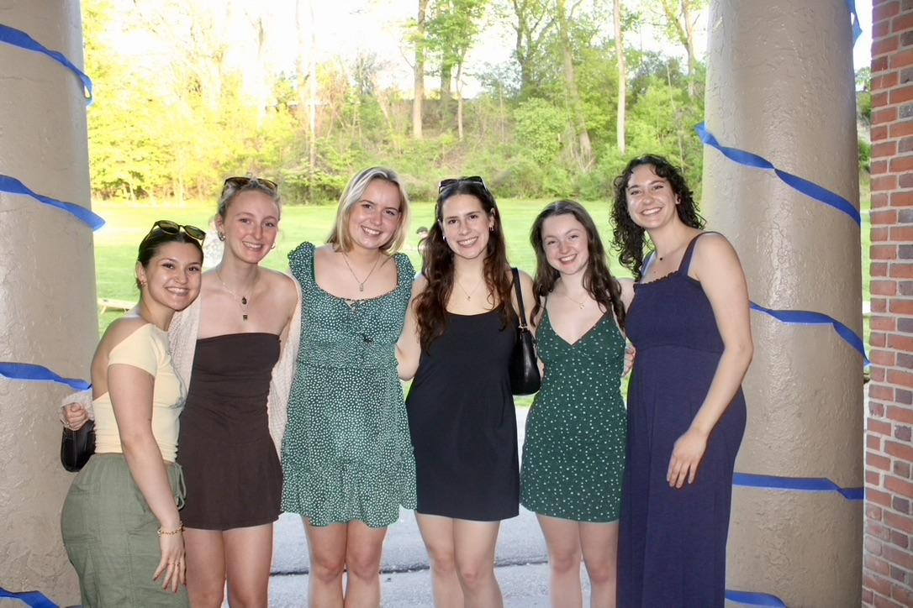
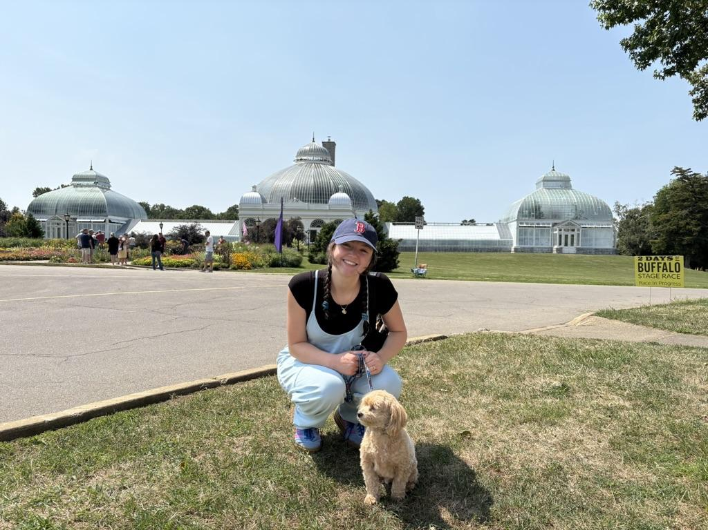
VP: Leah Stone - lgs35@pitt.edu
Welcome friends!
Check out the NSA Website!
The Stethoscoop!
  Weekly newsletter on all things Pitt Nursing & Healthcare!
  Interested in writing an article for the Stethoscoop? Fill out this form!
  Student Spotlight
  Pet of the week
Interested in Leadership?
  I’d love to chat!!
  (716)628-3576
  I’m here if you need anything!!
About Me!
Senior from Buffalo, NY!
Love baking/traveling/reading
SNI & PCT on pediatric transplant unit!
Involved in URMP and TA for Micro+A&P
Studied abroad in Ireland
NEC East & Chair on NSNA Board!

Slide 6
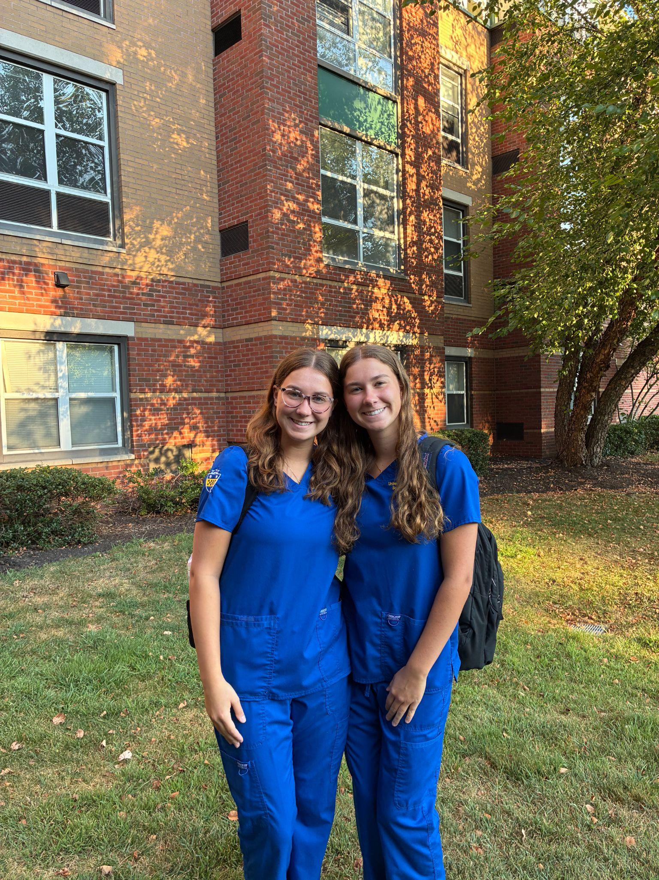
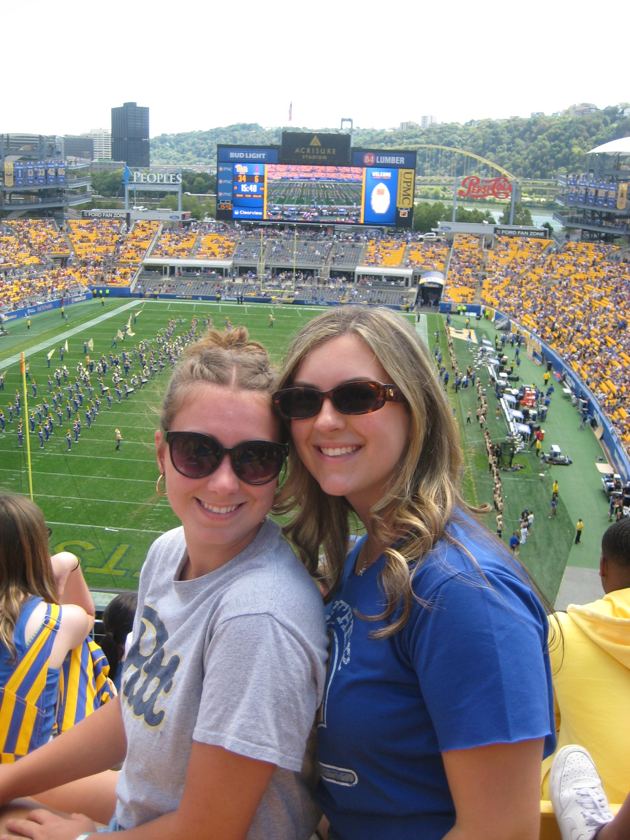
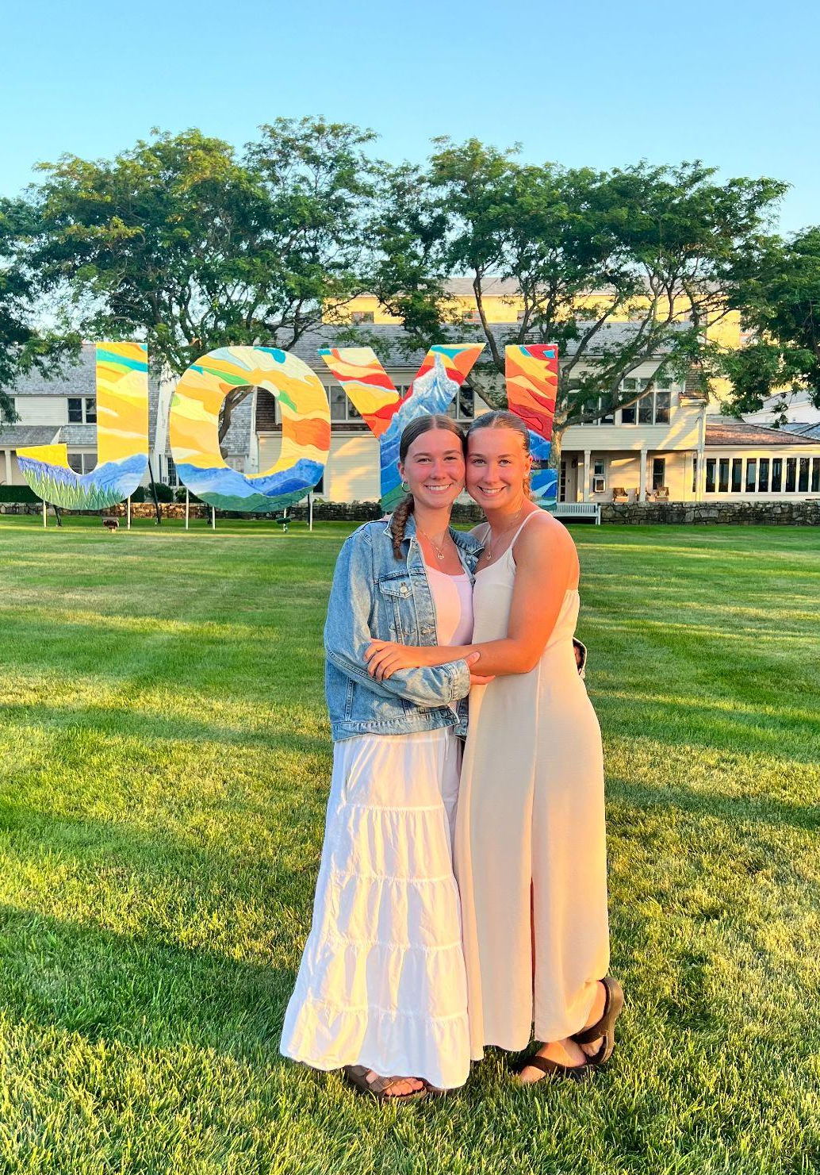
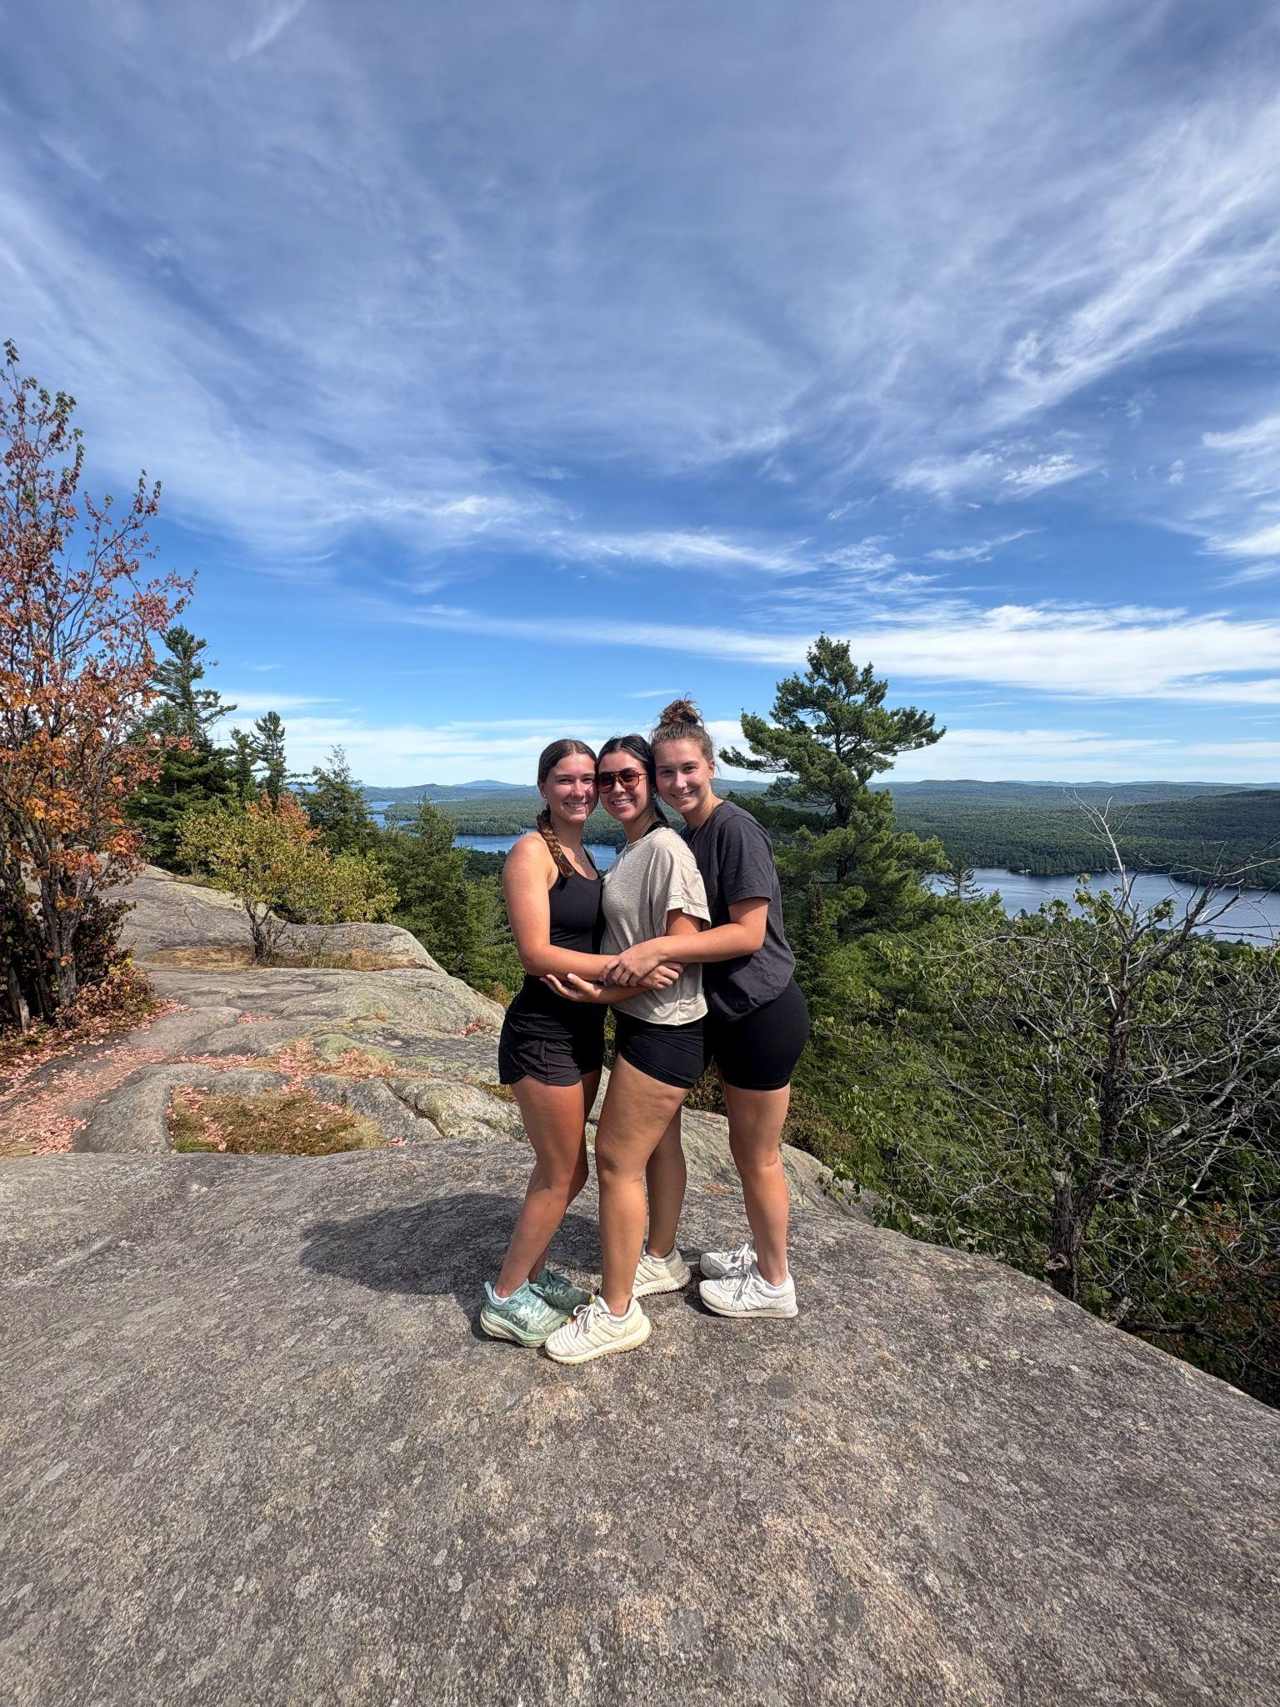

Business Manager: Ally Vicks - alv112@pitt.edu
Membership Dues!
Benefits of paying dues: becoming a member of our national and state organization, scholarship opportunities, Imprint subscription, discounts on nursing resources, opportunity for honors society, leadership skills and professional development, and you can apply to attend our state and national conventions!
Each student pays dues annually, costing $15. Dues must be paid by cash/check (made out to the University of Pittsburgh)
New or returning members who paid last fall- plan for dues collection these days:
Before and after GBM - September 8th
First floor lobby of Victoria - 6pm-7pm Thursday September 18th
First floor lobby of Victoria - 6pm-7pm Tuesday September 23rd
Before and after GBM - September 24th
Before and after GBM - October 6th
If you cannot attend these meetings, fill out this form to arrange a time for dues collection.
Also, everyone please fill out THIS FORM before paying your dues!
Financial Feedback Form
About me:
From Rochester, NY
I love taking walks, cooking, watching The Summer I Turned Pretty (team Conrad ofc)
Brusters is my favorite ice cream in the world - chocolate raspberry truffle
Involved in URMP - reach out with any questions!
Nurse Extern in Rochester on a transplant floor
Currently hope to be a L+D nurse!

Slide 7

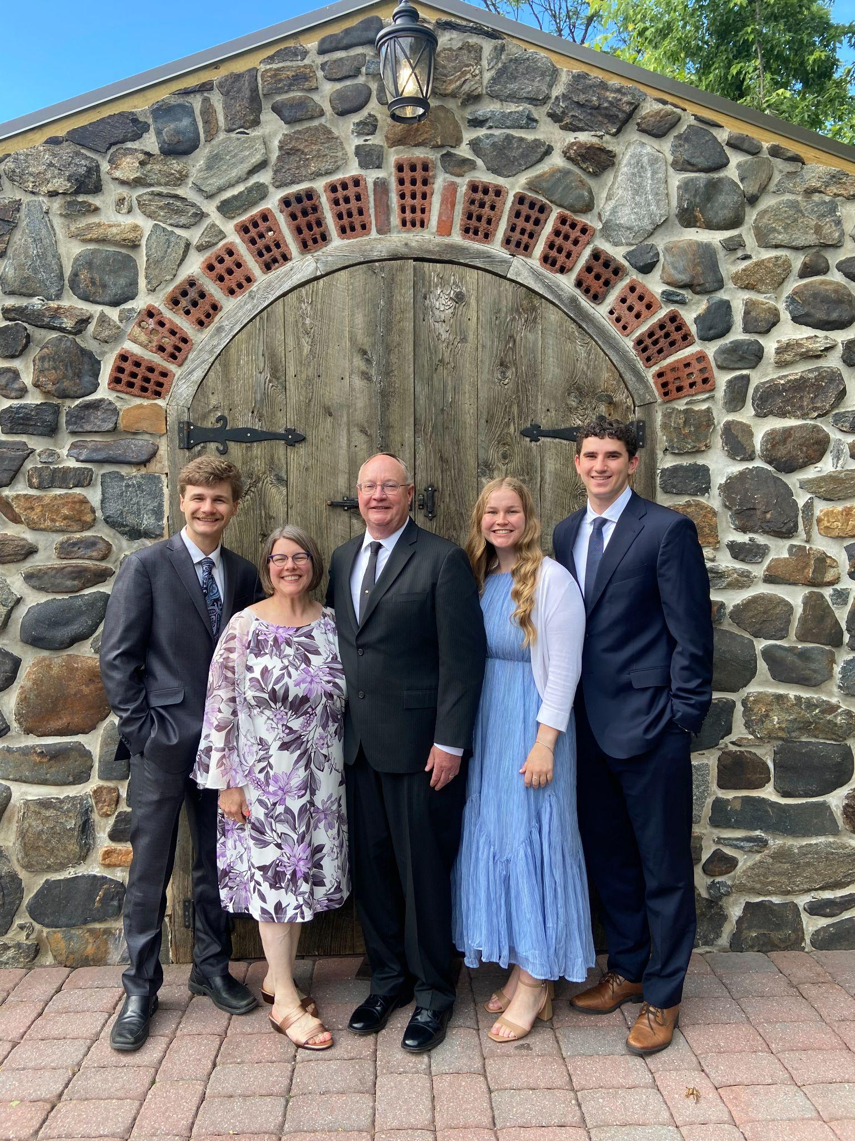
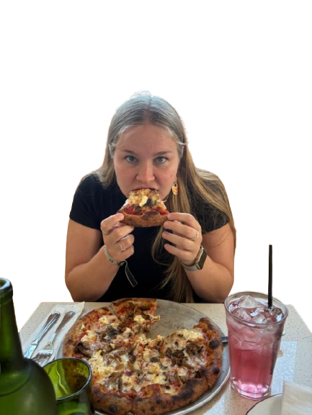
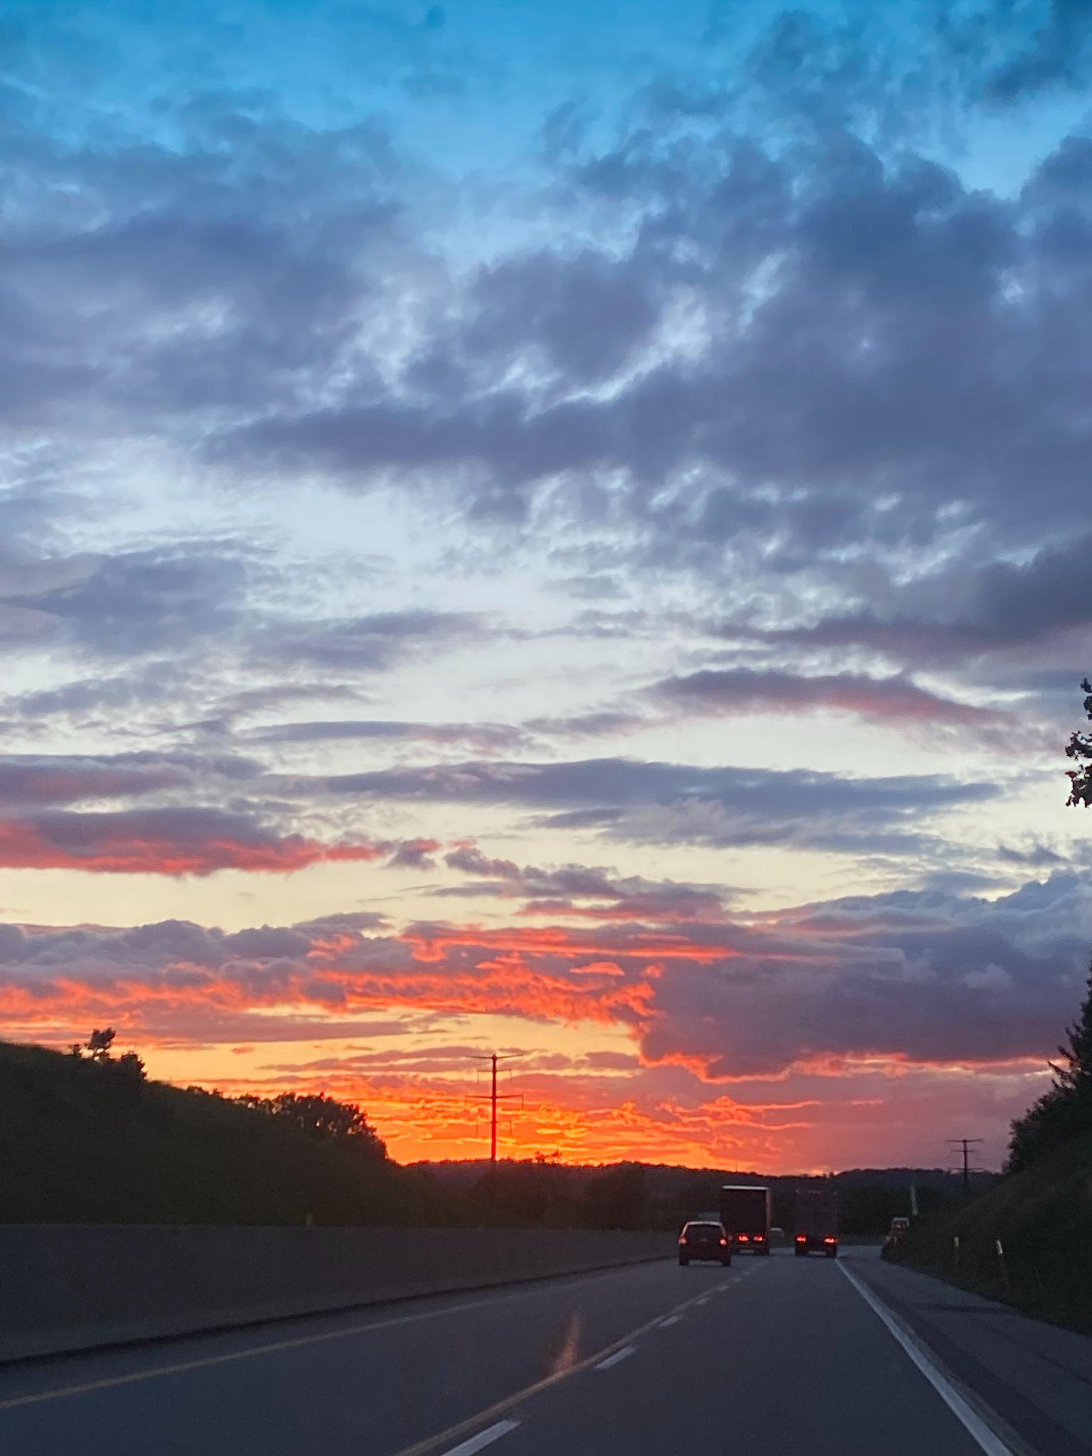
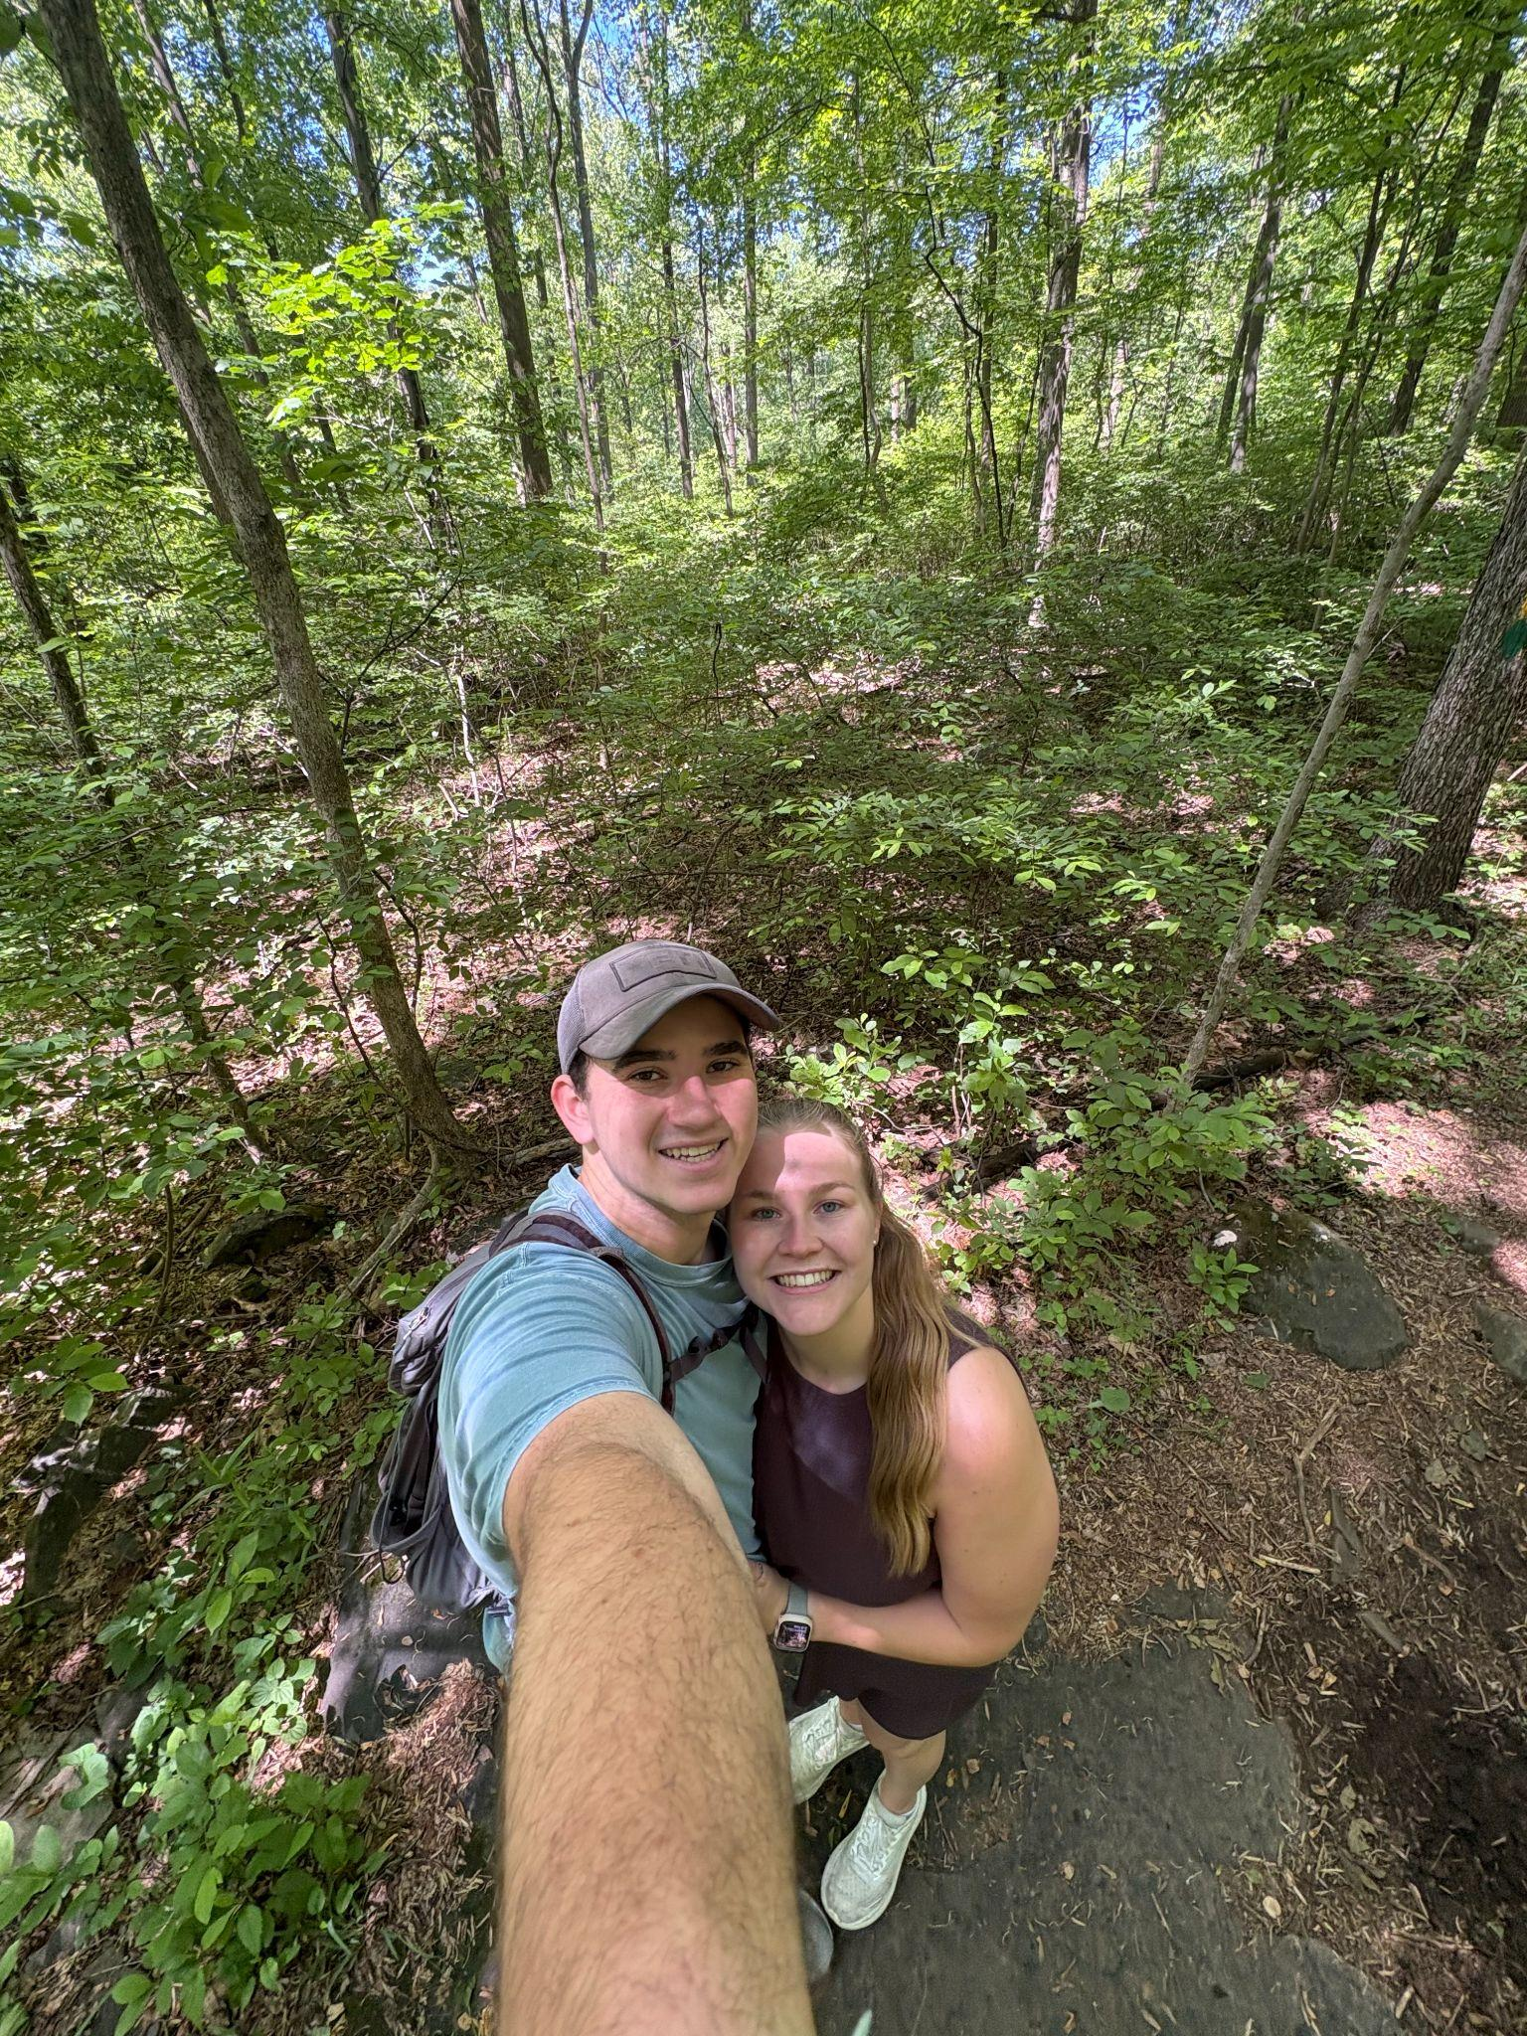
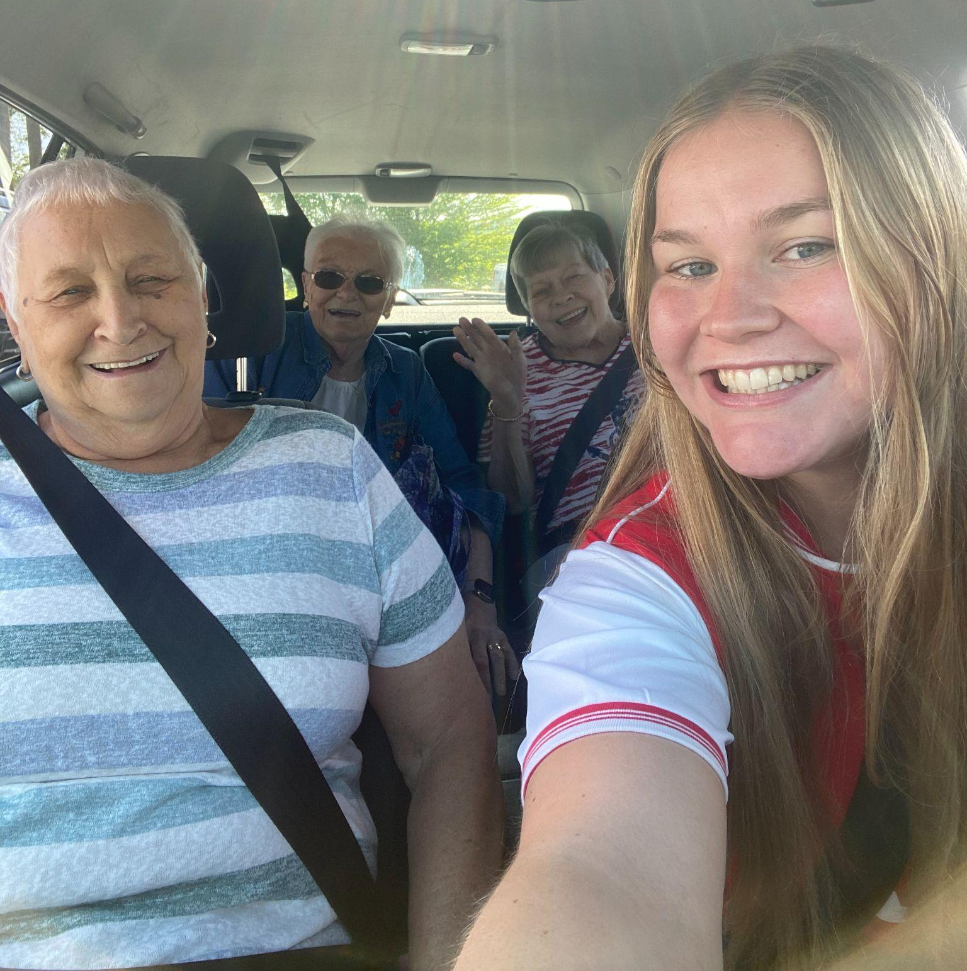
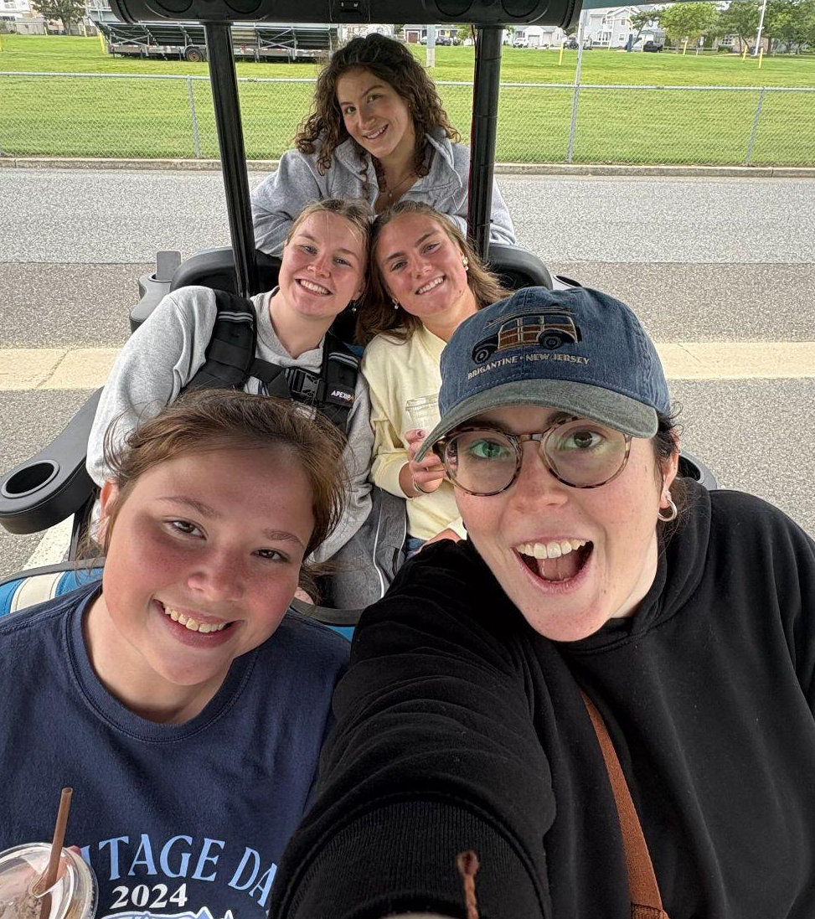
Secretary: Ann Barney - acb176@pitt.edu
100 points a semester to be an active member!!
GBM’s are 10 points and events vary!
All points are recorded on the attendance spreadsheet
Please fill out the Event Attendance for all events and scan the QR code at the end of the presentation for GBM’s!
Add your email in the GBM response
only if you are NOT receiving emails!!
about me
From Lancaster, PA
Love walking, grabbing tea, and new food
Externship at my local hospital in the ICU
I love ice-cream !!!
Involved in Cru, URMP, UTA, and I studied abroad!
Currently serving on the SNAP board!
Let me know if i can help you in any way!!!

Slide 8
Secretary Links | Connect with NSA
Event Attendance Form: for any event or outside activity completed to earn points Link: https://forms.gle/7y2Cm8DFVQFLWiVb9 Also hyperlinked in Secretary emails–click “Nursing Student Association” | Email: send us any questions, comments, or suggestions you have throughout the semester pittnsa@gmail.com
GBM Attendance Form: for GBMs only Scan QR code at end of GBMs | Instagram: meeting reminders, event updates and pictures, and more @pittnsa
Attendance Spreadsheet: view to track how many points you have earned toward membership Link: Attendance Form Also hyperlinked in Secretary emails–click “Secretary” | Website: NSA master calendar, important links, student spotlights, and more https://pittnsa.wixsite.com/pitt

Slide 9


GBM’s
9/8
9/24
10/6
10/22
11/3
11/17

Slide 10
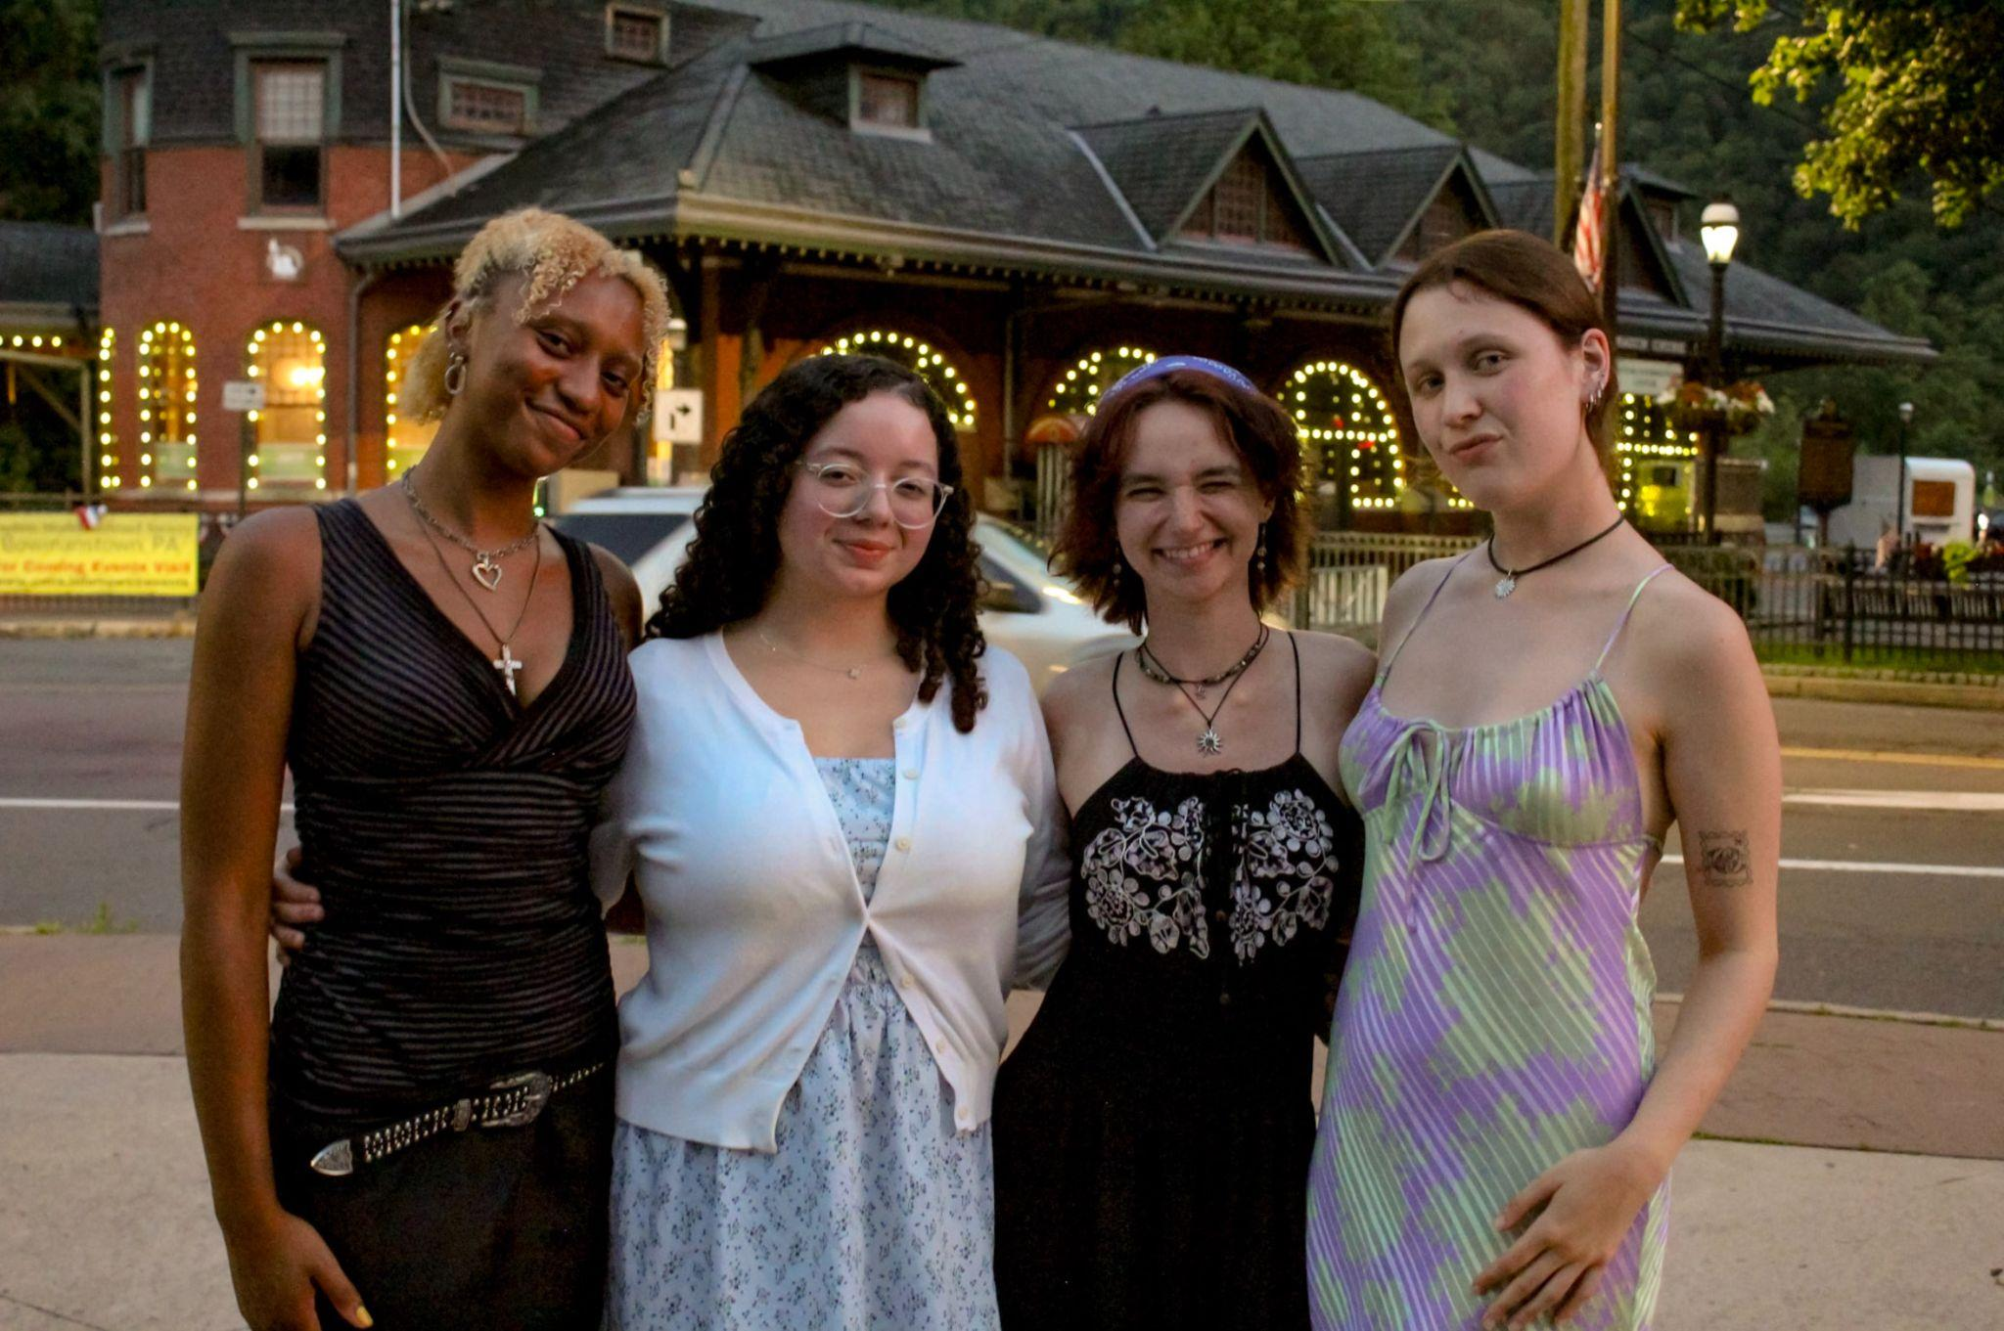
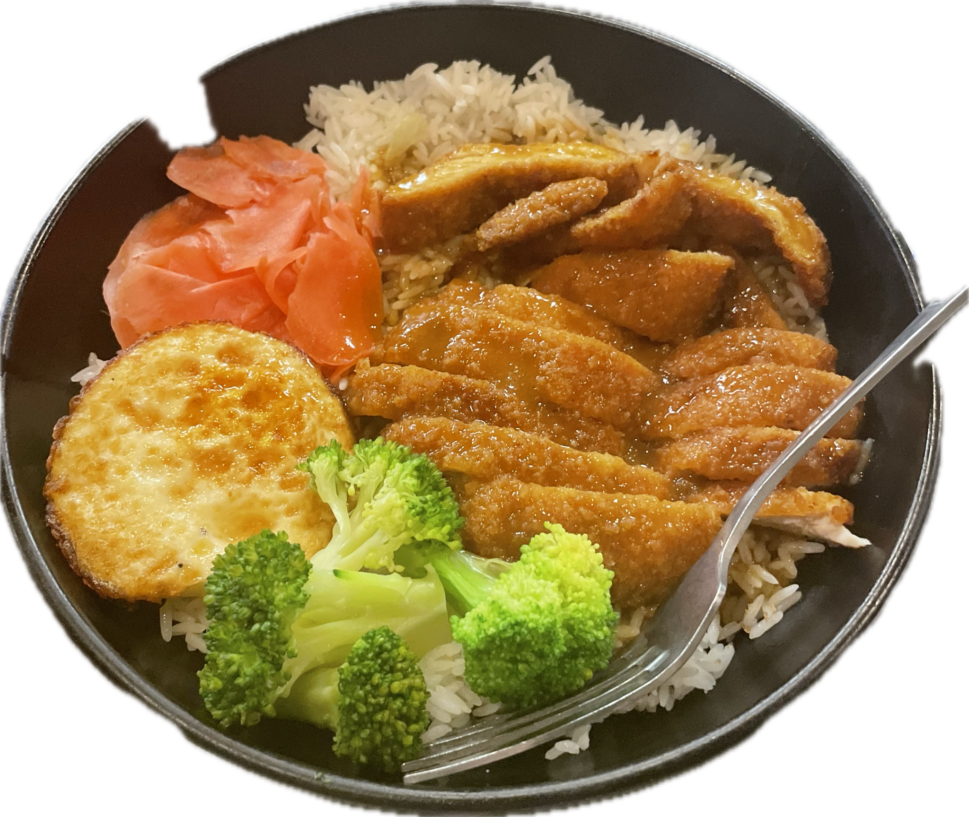
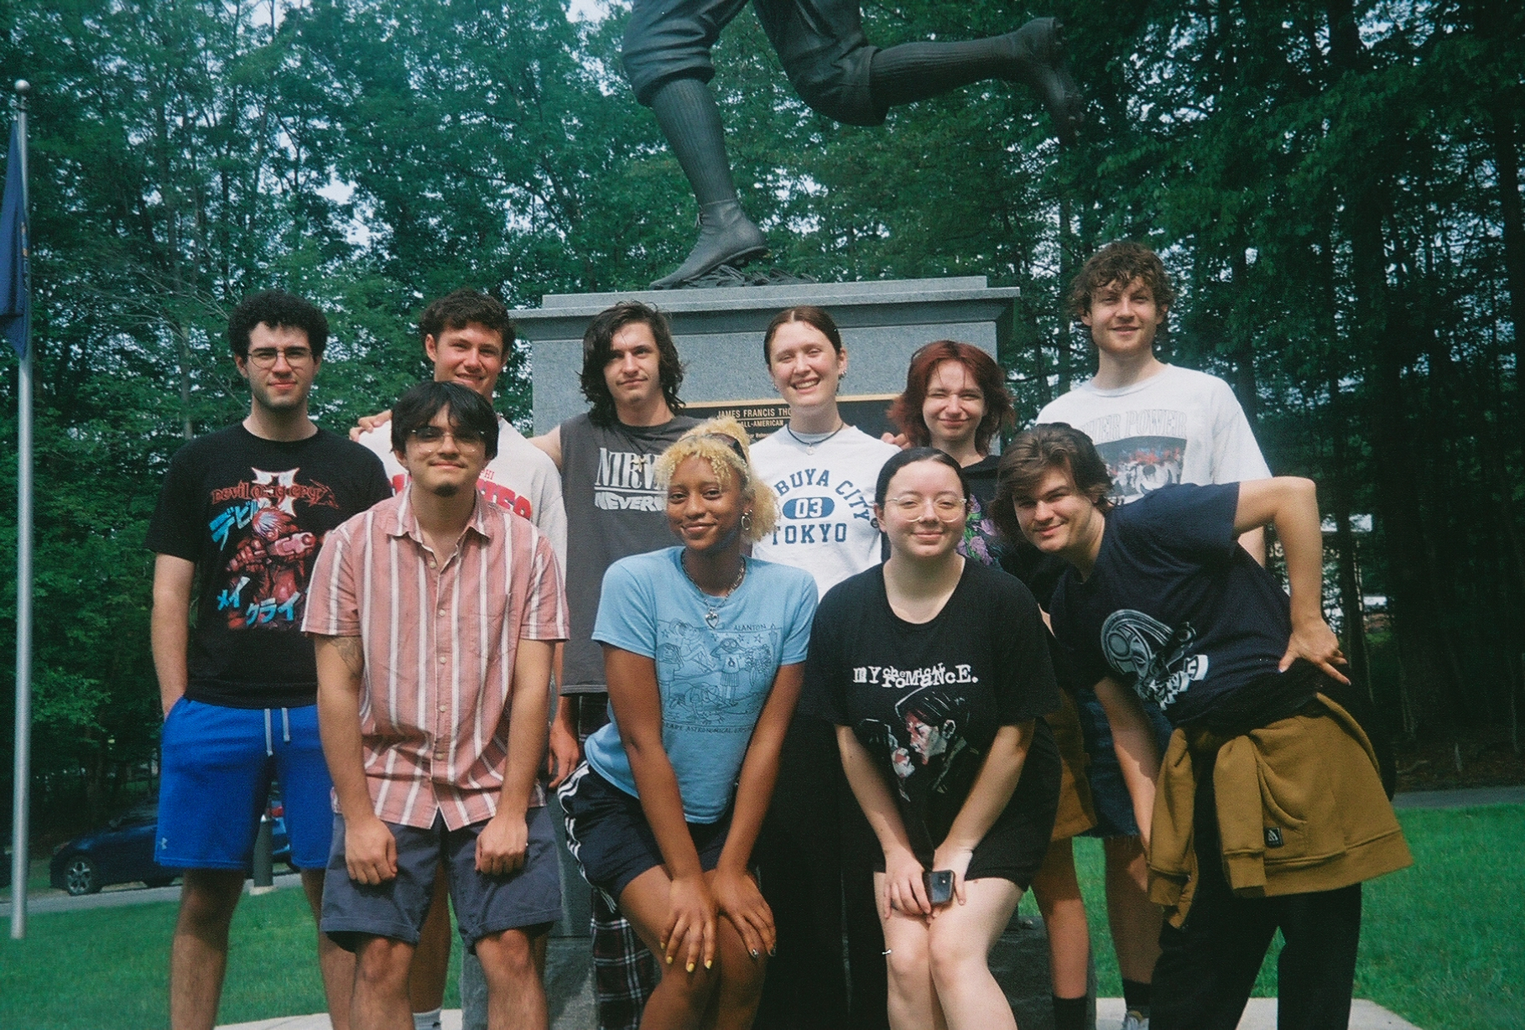
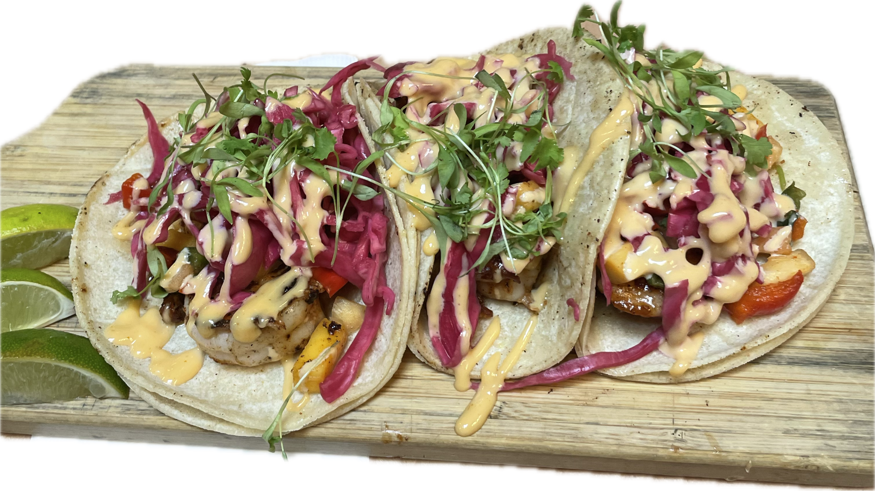
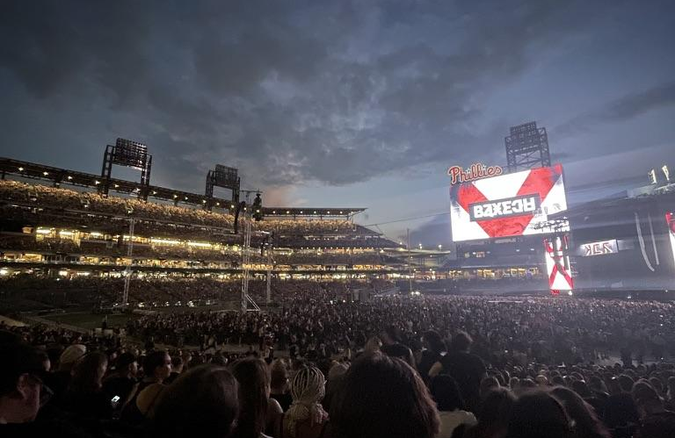


Professional Development: Sophia Espaillat - sme81@pitt.edu
Hi everyone! So good to see you!! 😊
Fall Leadership Series
First Session: NSNA & SNAP + Your Leadership Color on 9/22 at 6:30 in VIC 262
  Interest Form
Resolutions Committee
Info Sheet
Interest Form DUE 9/15
SNAP Convention
Info Sheet
Interest Form
Midwife Center Tour 10/18 at noon
Interest Form
Leave advice for 1st year students here!
What would you like to see from PD this semester? LMK HERE!
About me:
Junior from Metuchen, NJ
Work as a caregiver & at the ice cream shop in Schenley Plaza! Come say hi 😁
NEC West & Chair for SNAP - interested in running for state board? LMK!
Pumped gas like 3 times this summer #biggirl

Slide 11

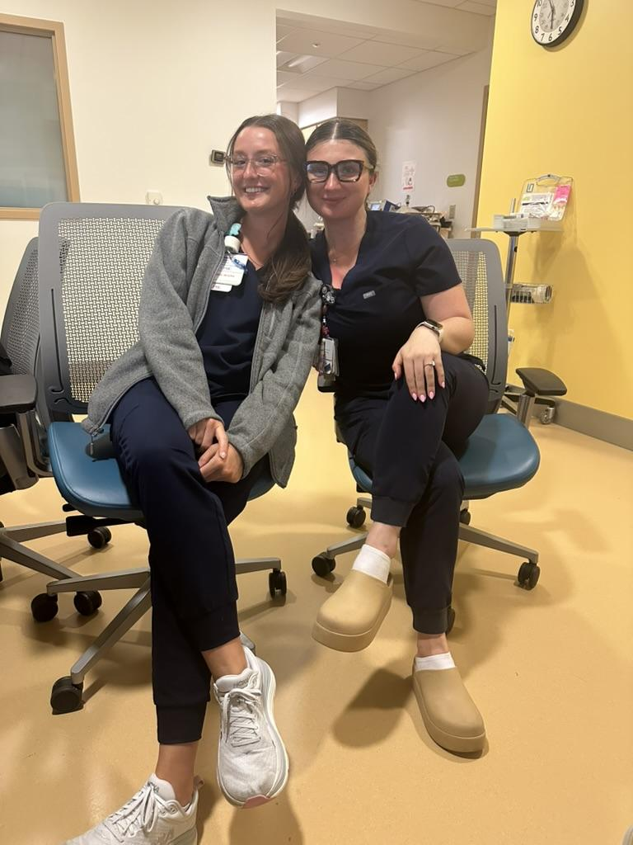
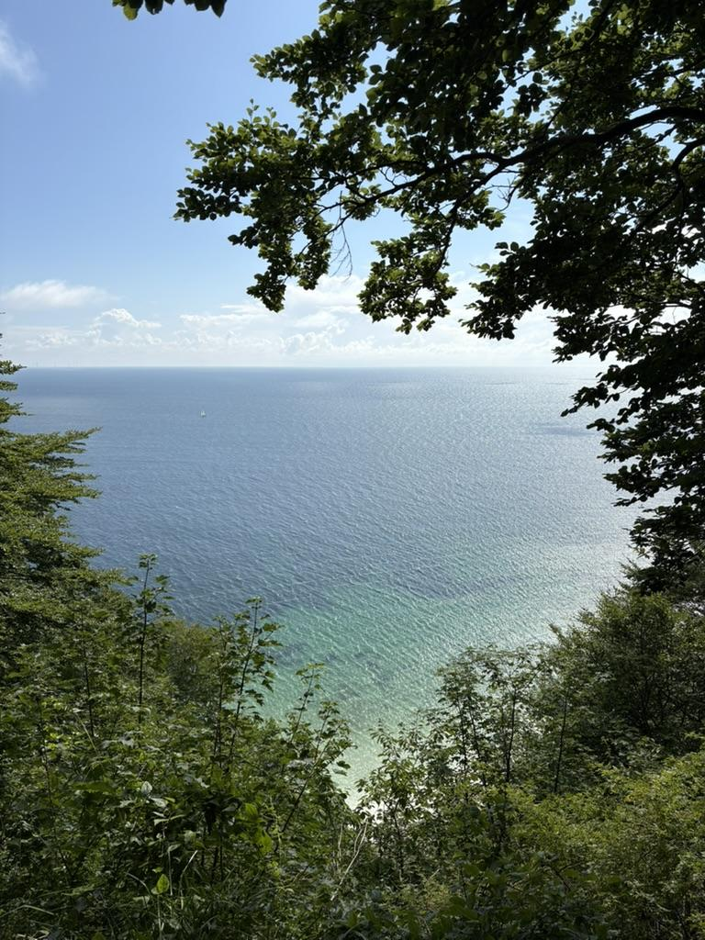
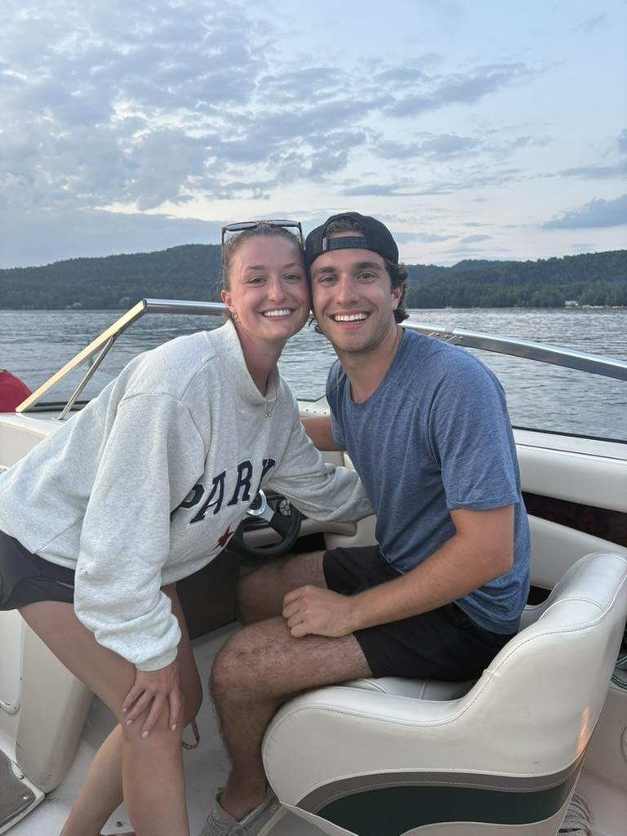
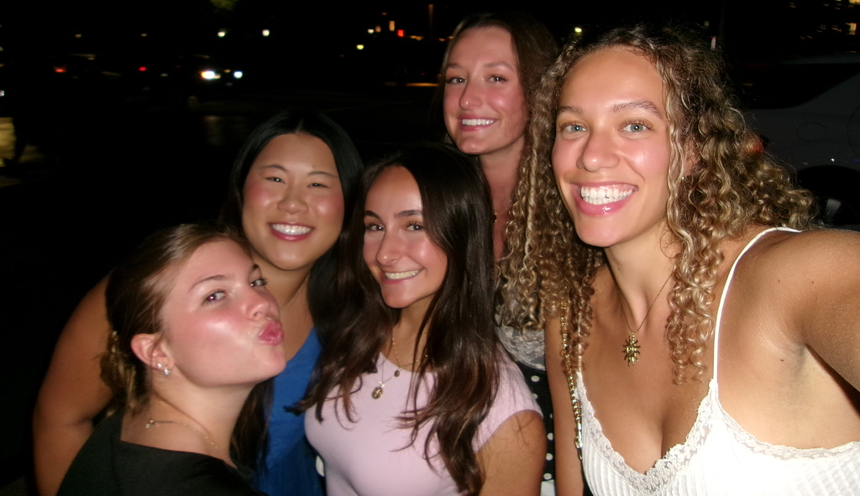

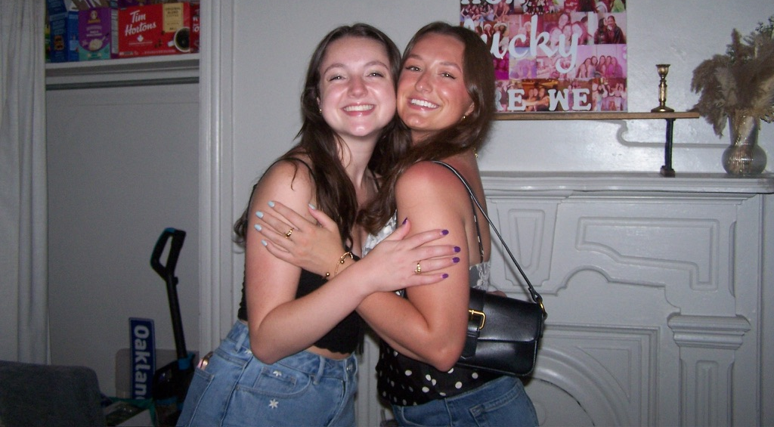
Social: Astrid Yerardi - asy30@pitt.edu
Welcome new & returning NSA members!!
Social Events Feedback Form!!
Social Media:
  @pittnsa on Instagram & TikTok!
Social Events!
  Thursday 9/11 @5-6pm: Ice Cream Social w/ Keio University Students (10pts)
  TBD: 4th Annual NSA Field Day!!! (10pts)
Big/Little Families (5pts/meetup, 15pt cap):
  Expanding on current families
  Find close friends/mentors within nursing
  Sign up for the program at future GBM
Social Committee:
  Help us plan and set up social events!!
  Use THIS LINK to sign up!
About Me:
Senior from Bedford, Massachusetts
Interested in Pediatric critical care (PICU)
SNI in PICU & PCT on Mother/Baby unit at Magee Women’s
I love being outdoors and travelling (did anyone go anywhere cool this summer?! I went to Scandinavia!)
I love coffee, tea, snacks, fall, and nursing…reach out anytime to talk or hang: @ayerardi22 on instagram!!

Slide 12
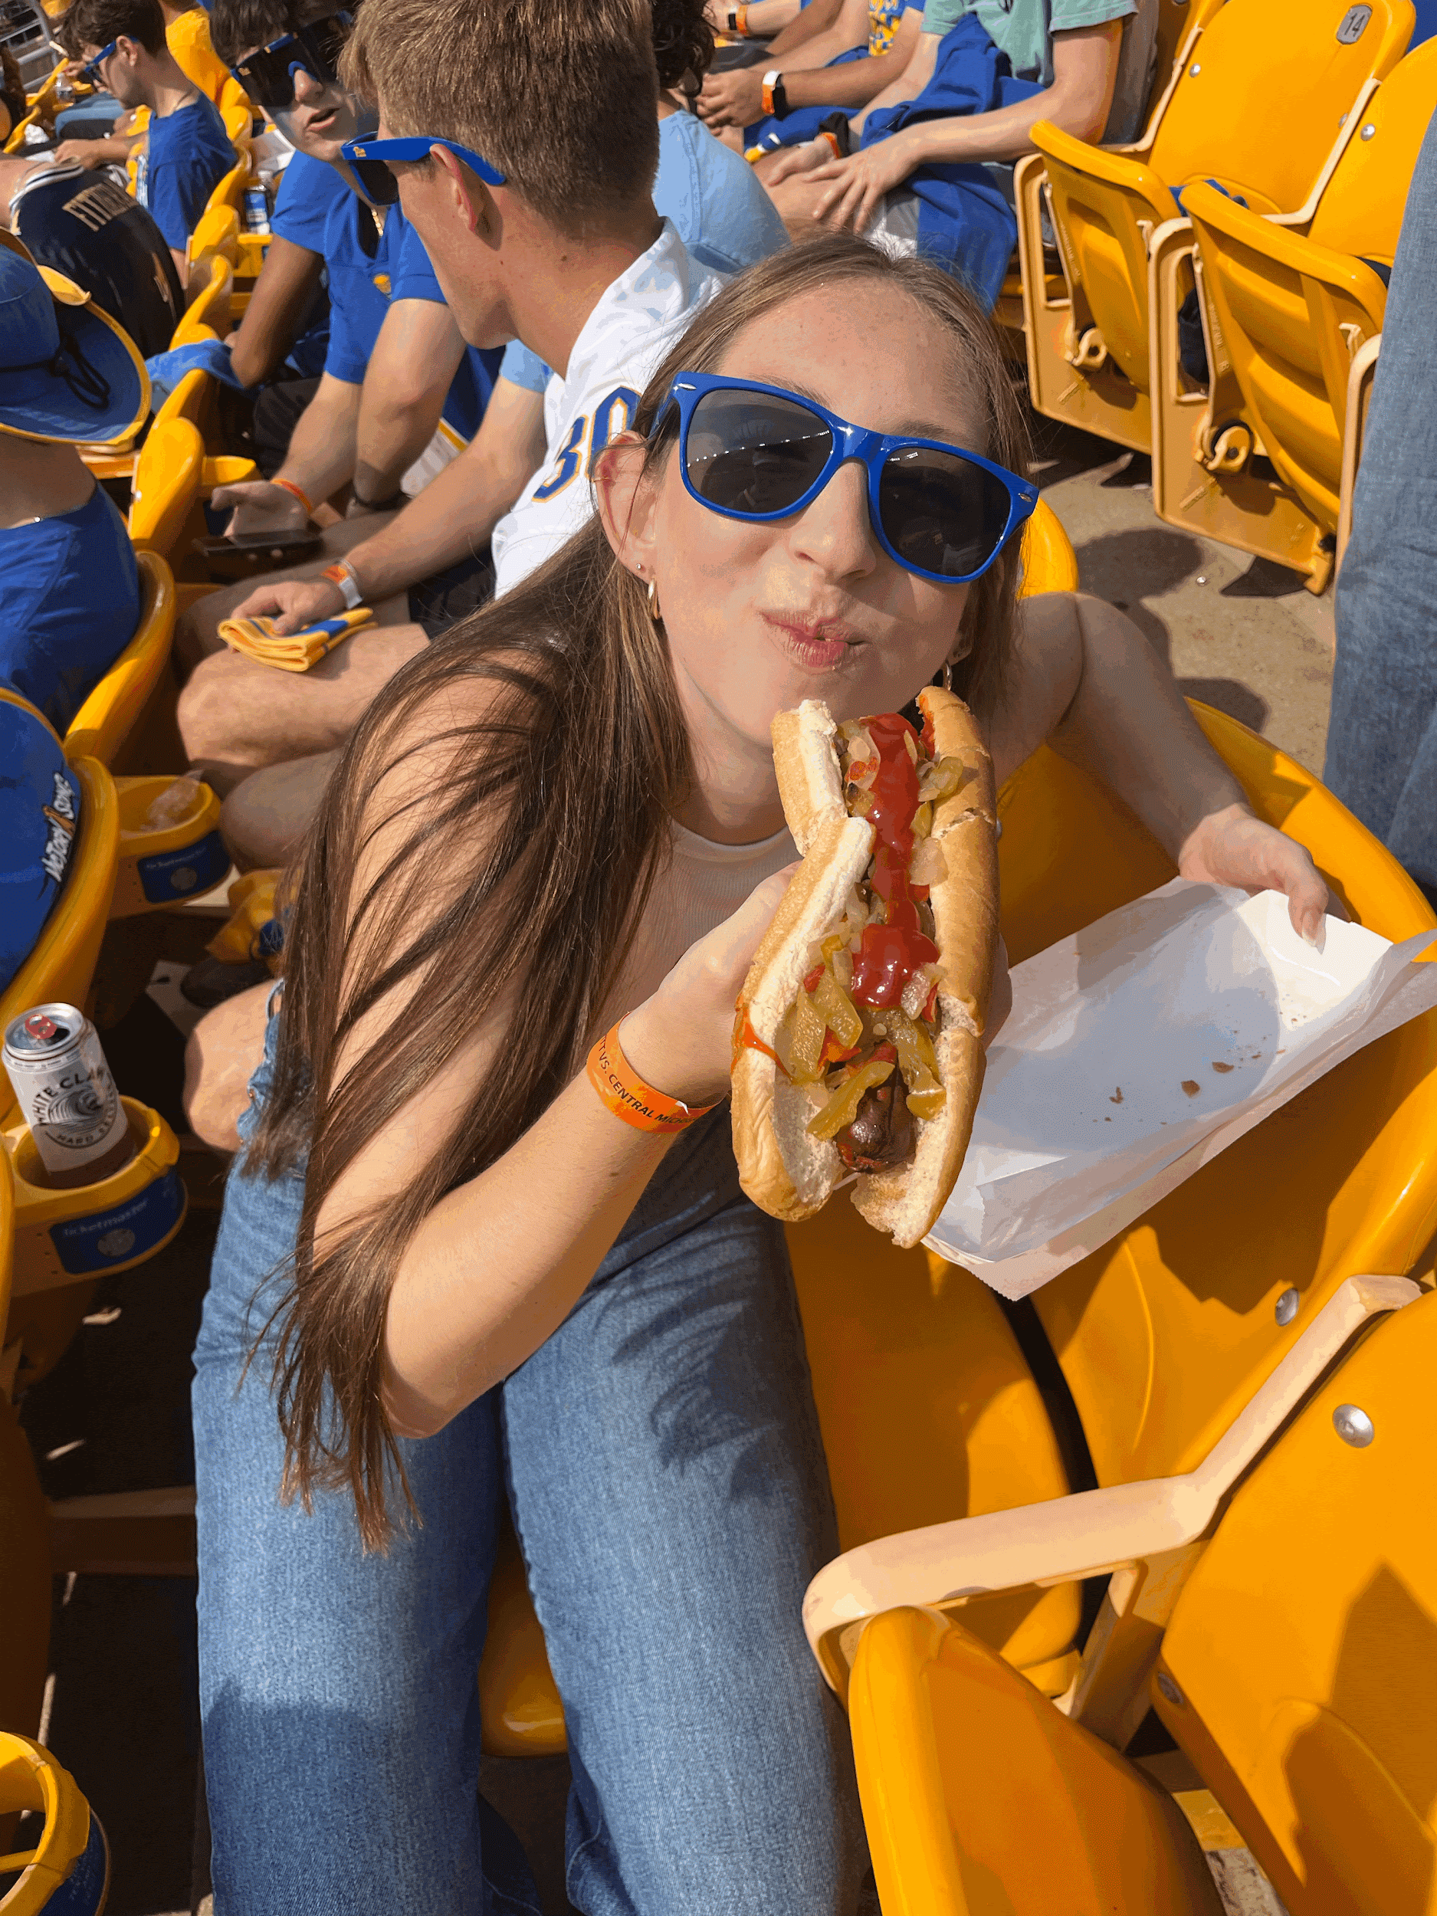
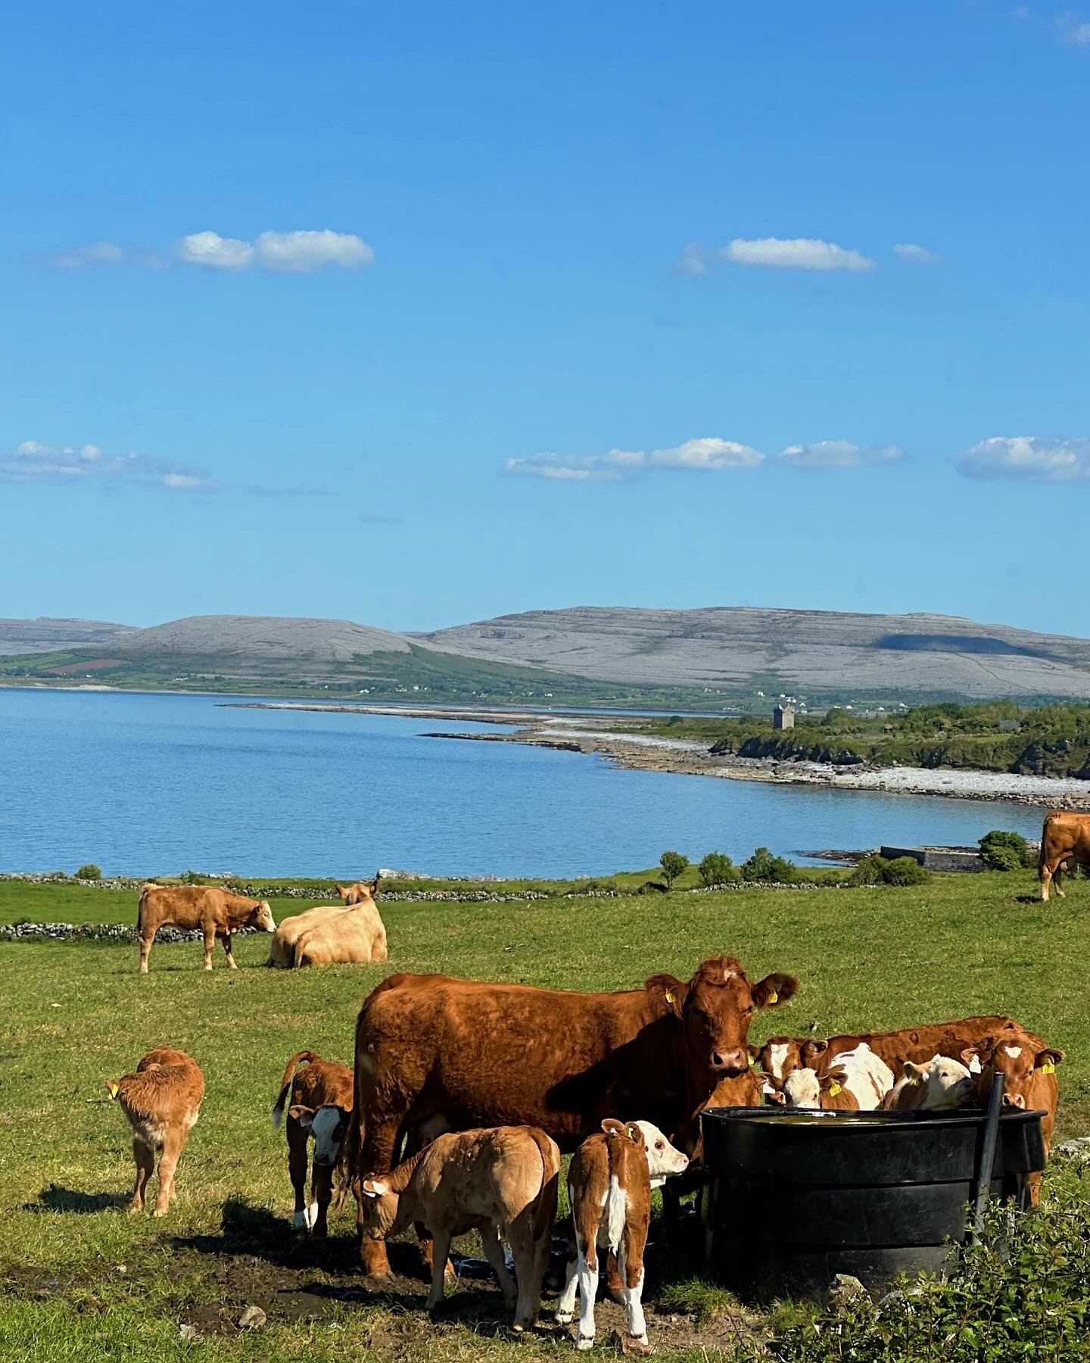
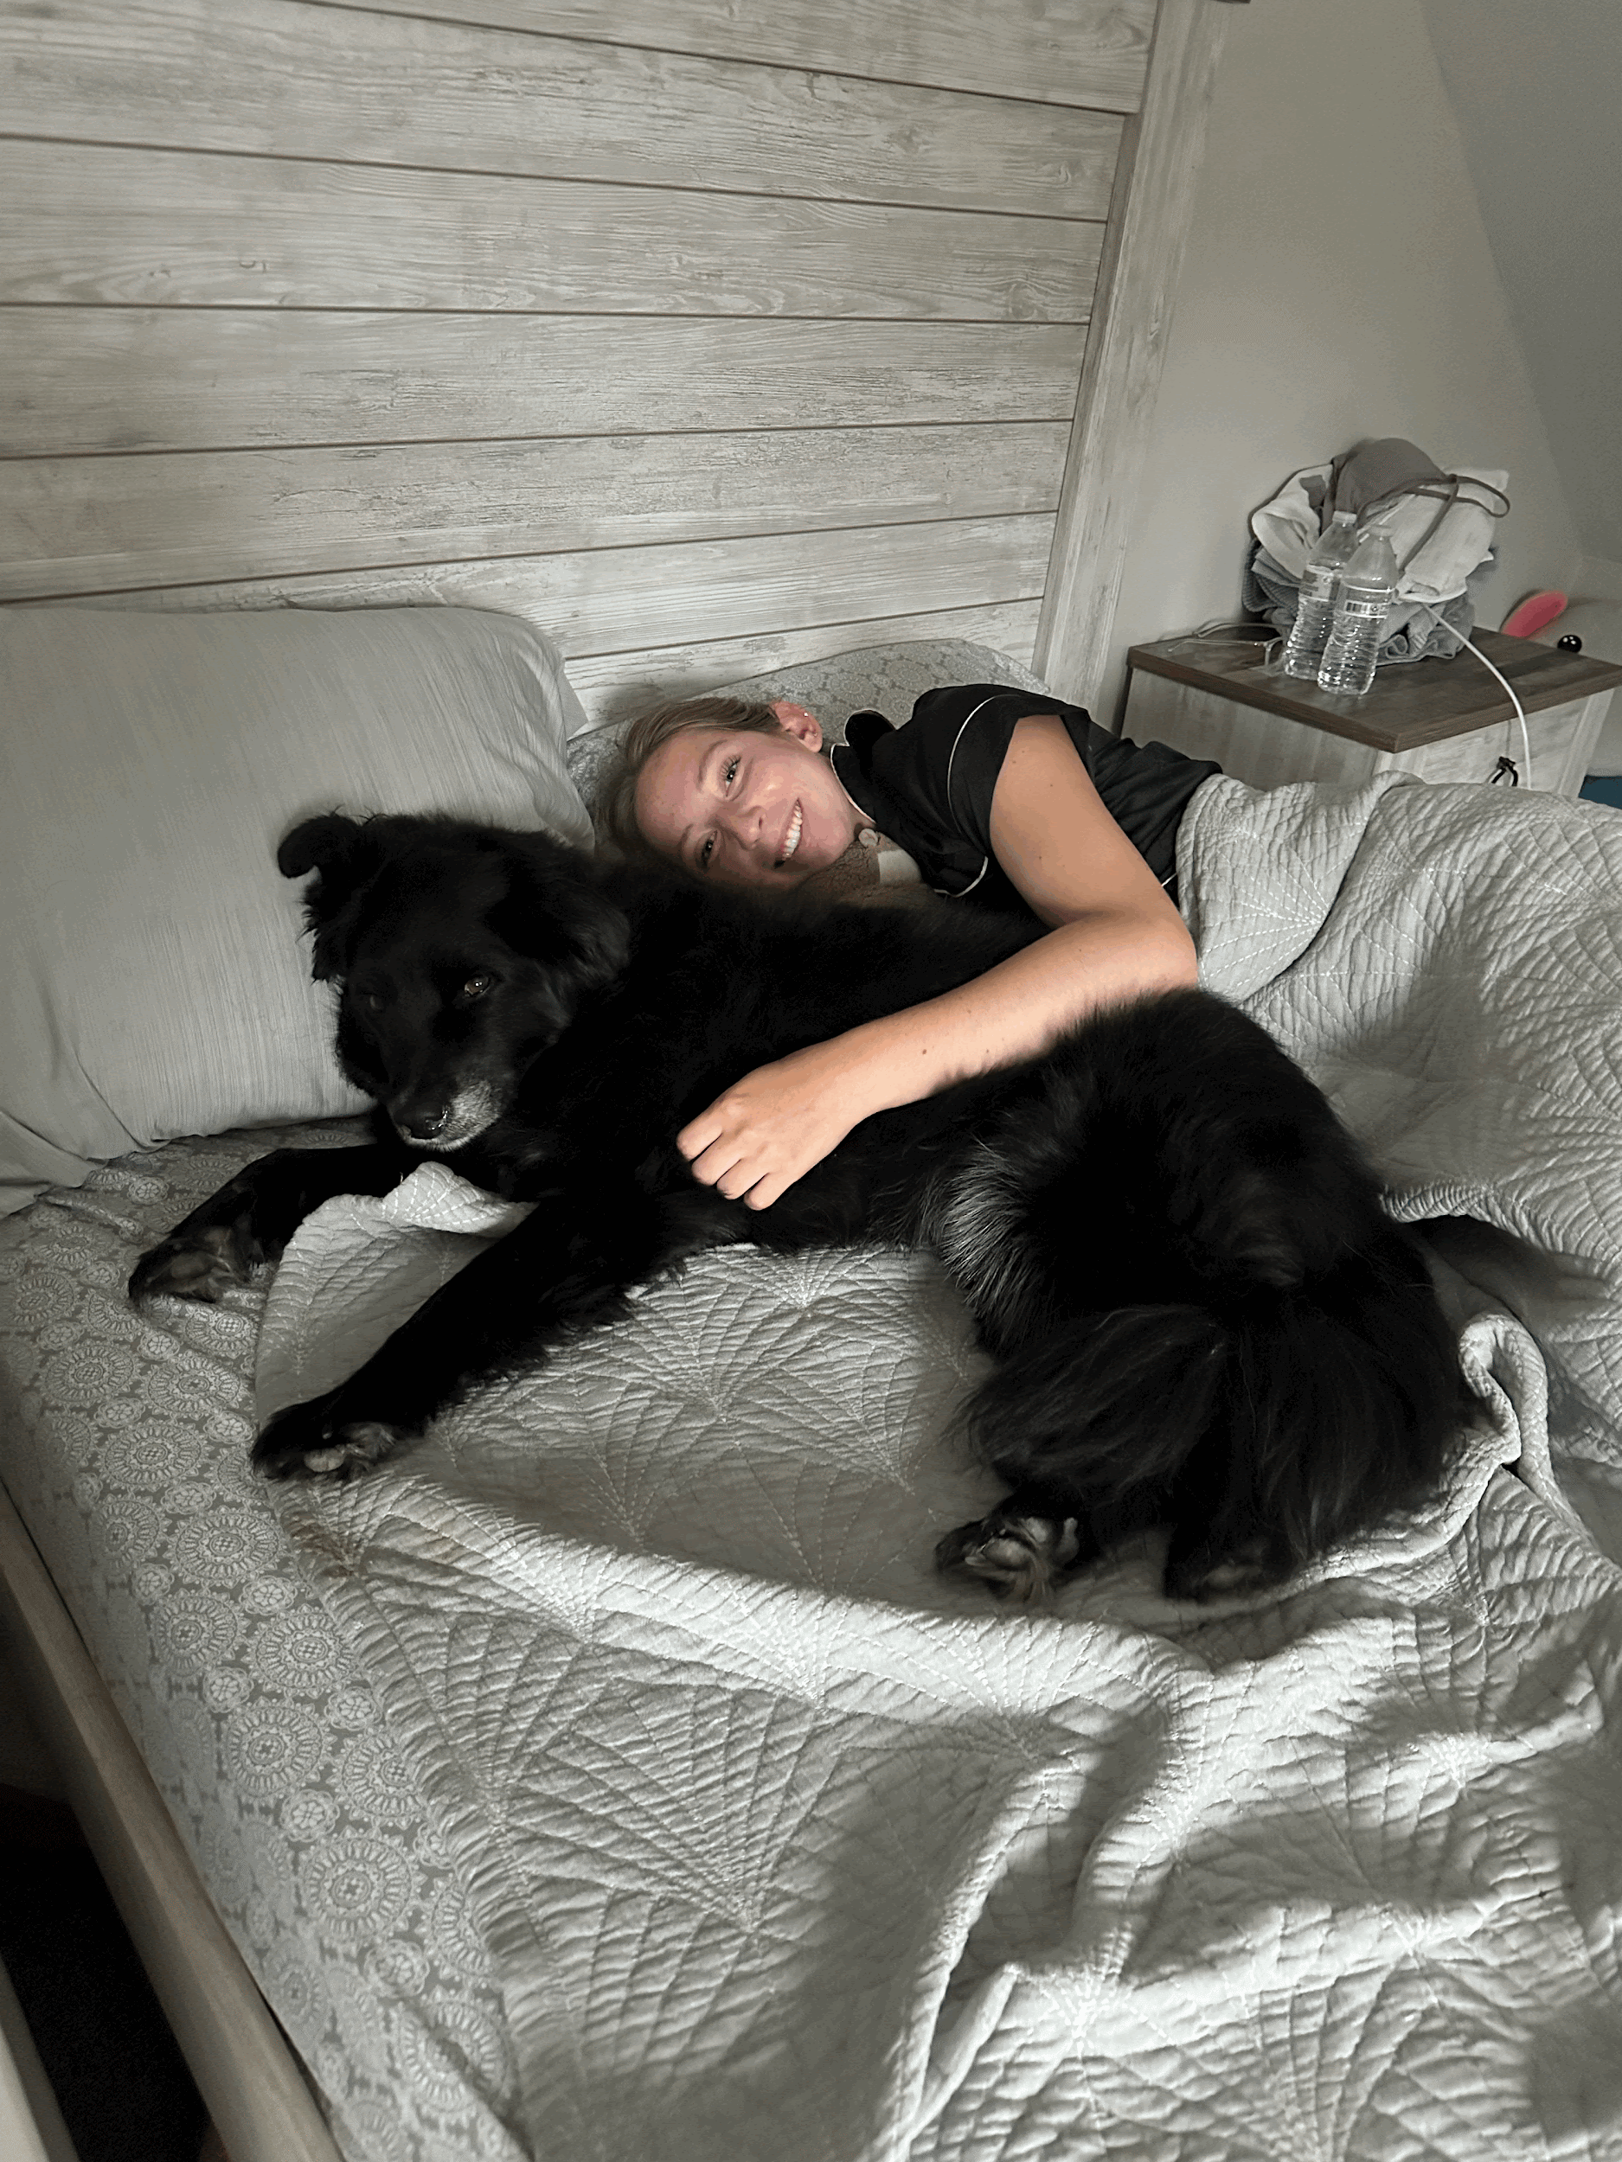
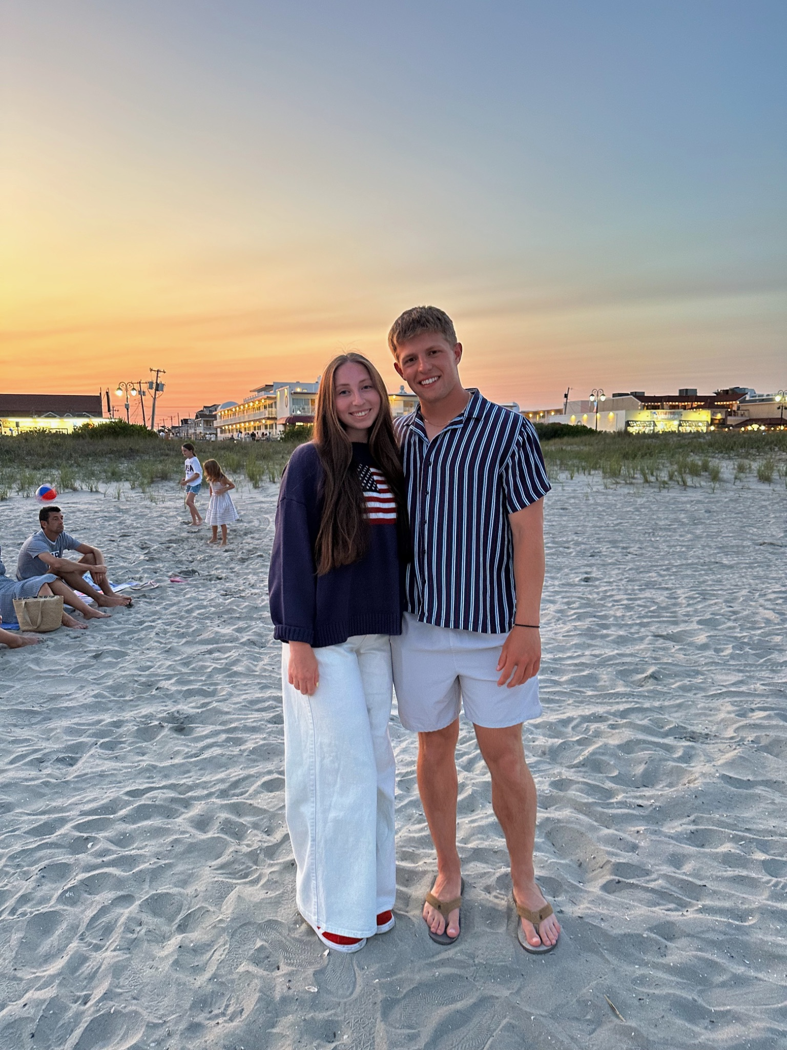
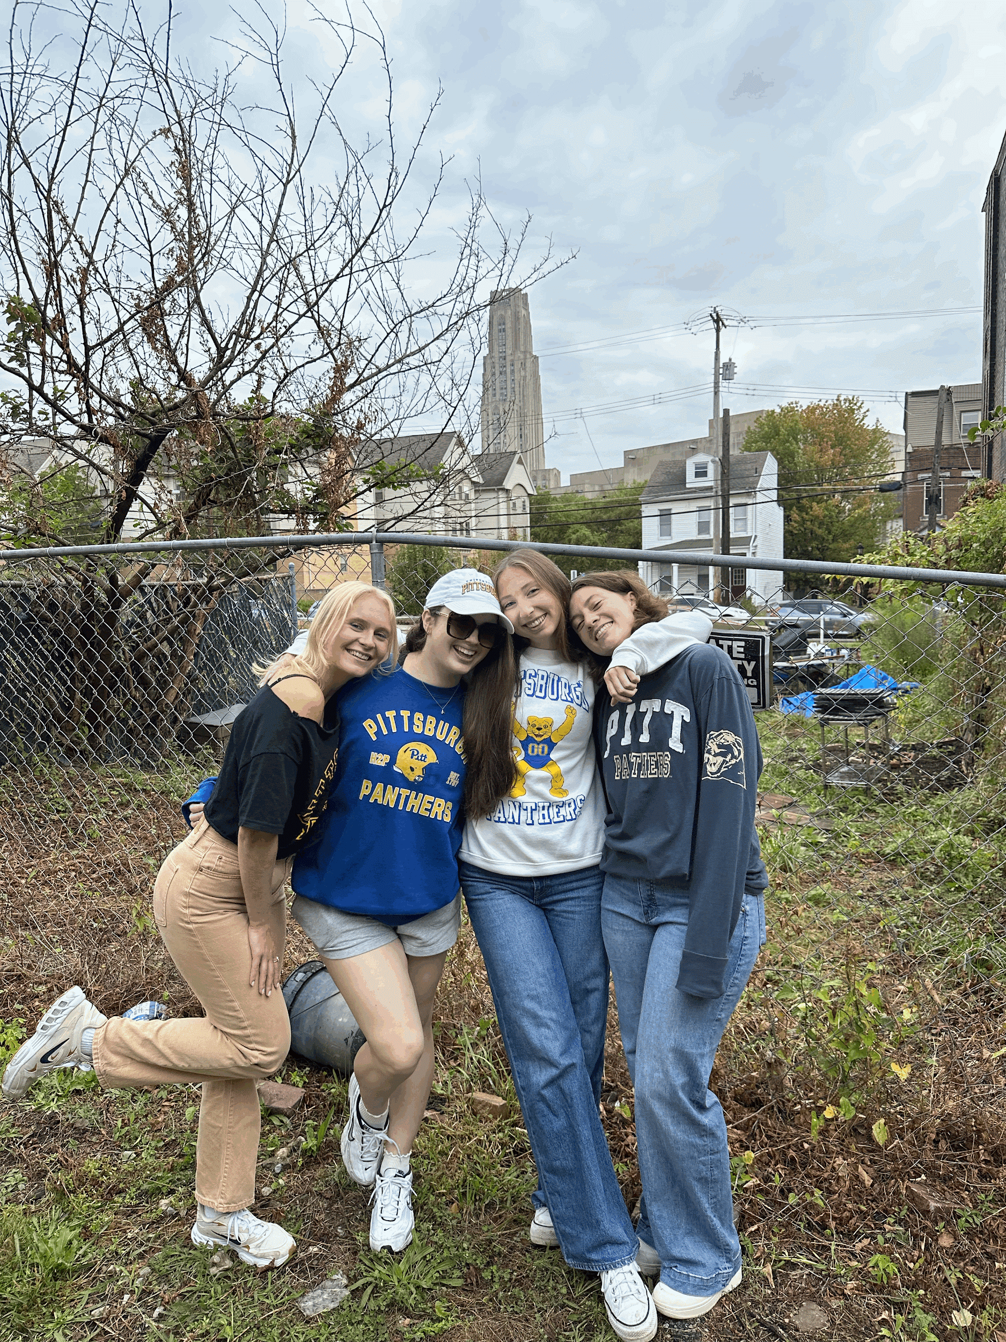
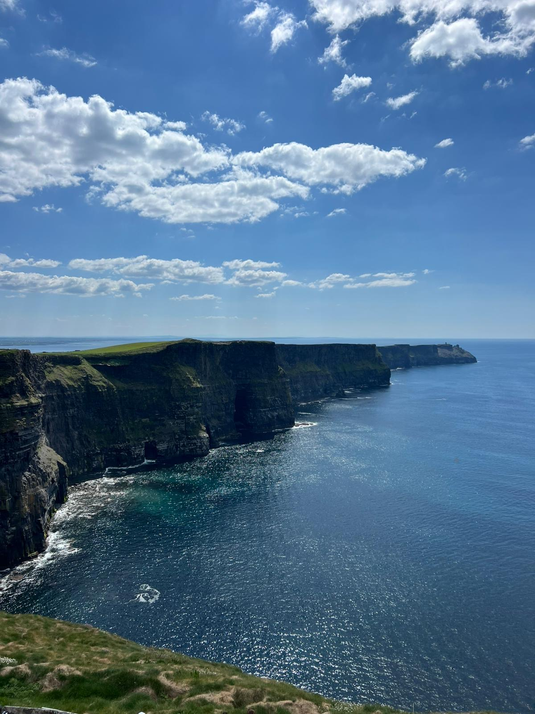

Service: Stephanie Adamousky - sja75@pitt.edu
In the process of planning my first few events!
  please fill out this form so I can gauge when the best days/times would be to have events :)
  event availability form
Some events I have in mind would only be possible if we carpooled there…
  please fill out this form if you have a car and would be willing to drive to events :)
  carpool form
General event idea form :)
  service event idea form
About Me
I am a junior from Bucks County, PA
I am on the women’s club volleyball team here at Pitt :)
I am a PCT at Children’s
I want to be a pediatric oncology nurse!
This summer I studied abroad in Ireland!
My all time favorite snack is microwave popcorn

Slide 13

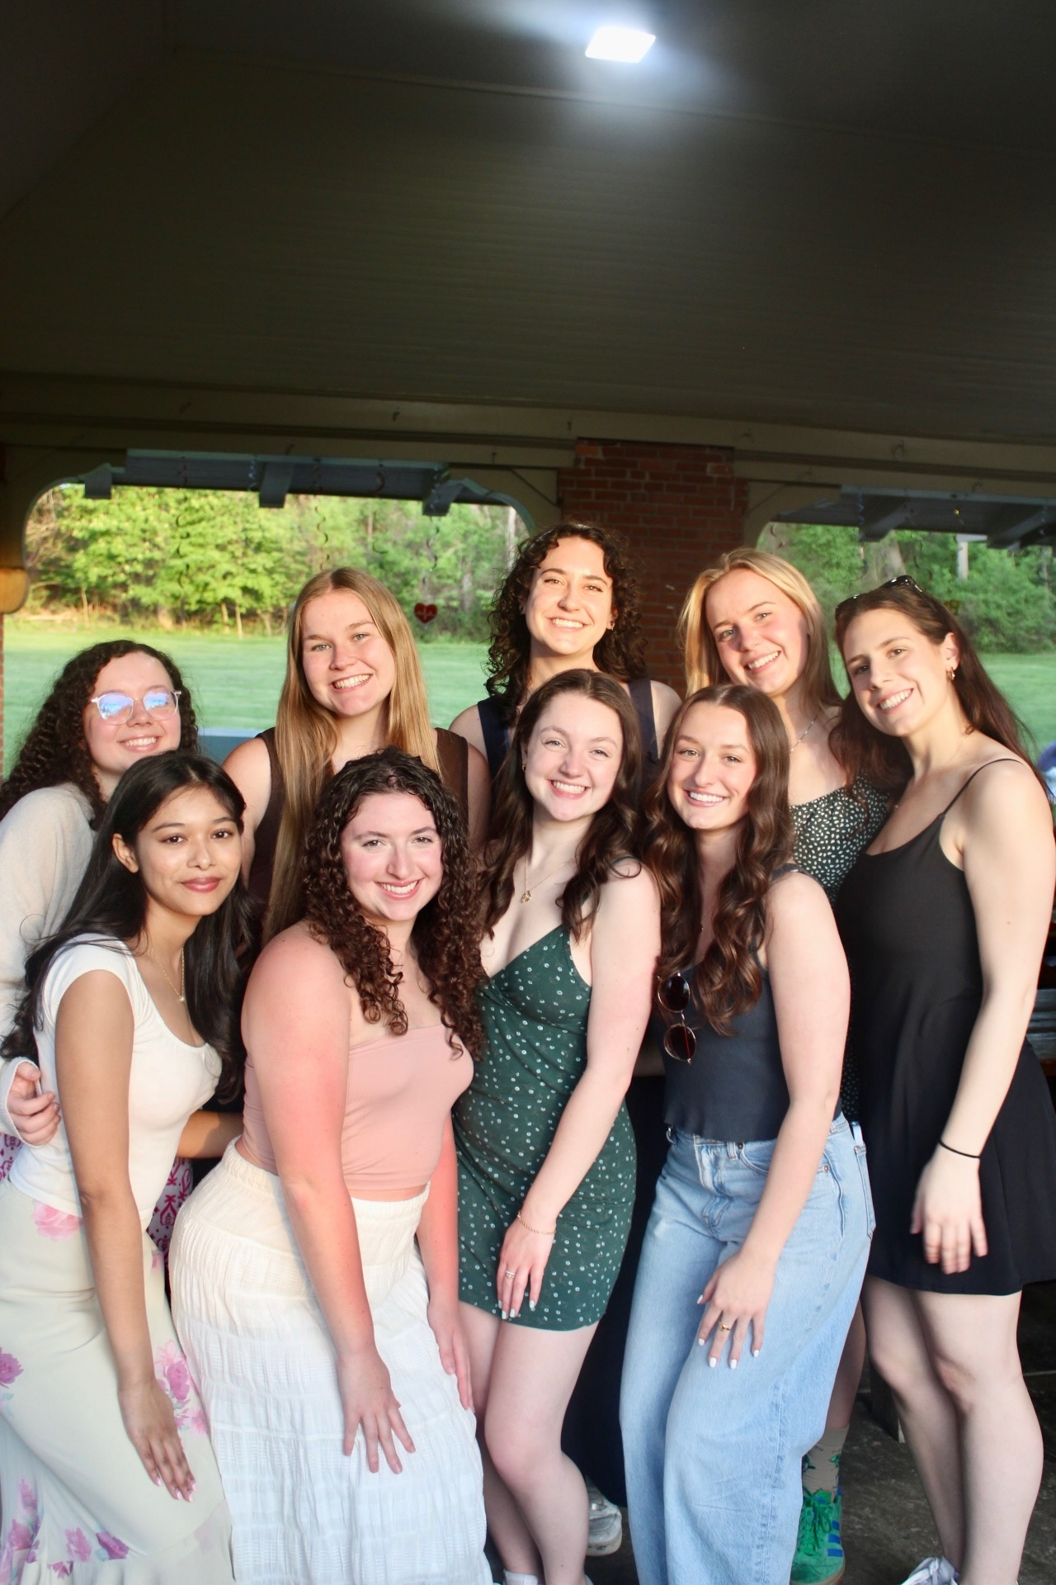
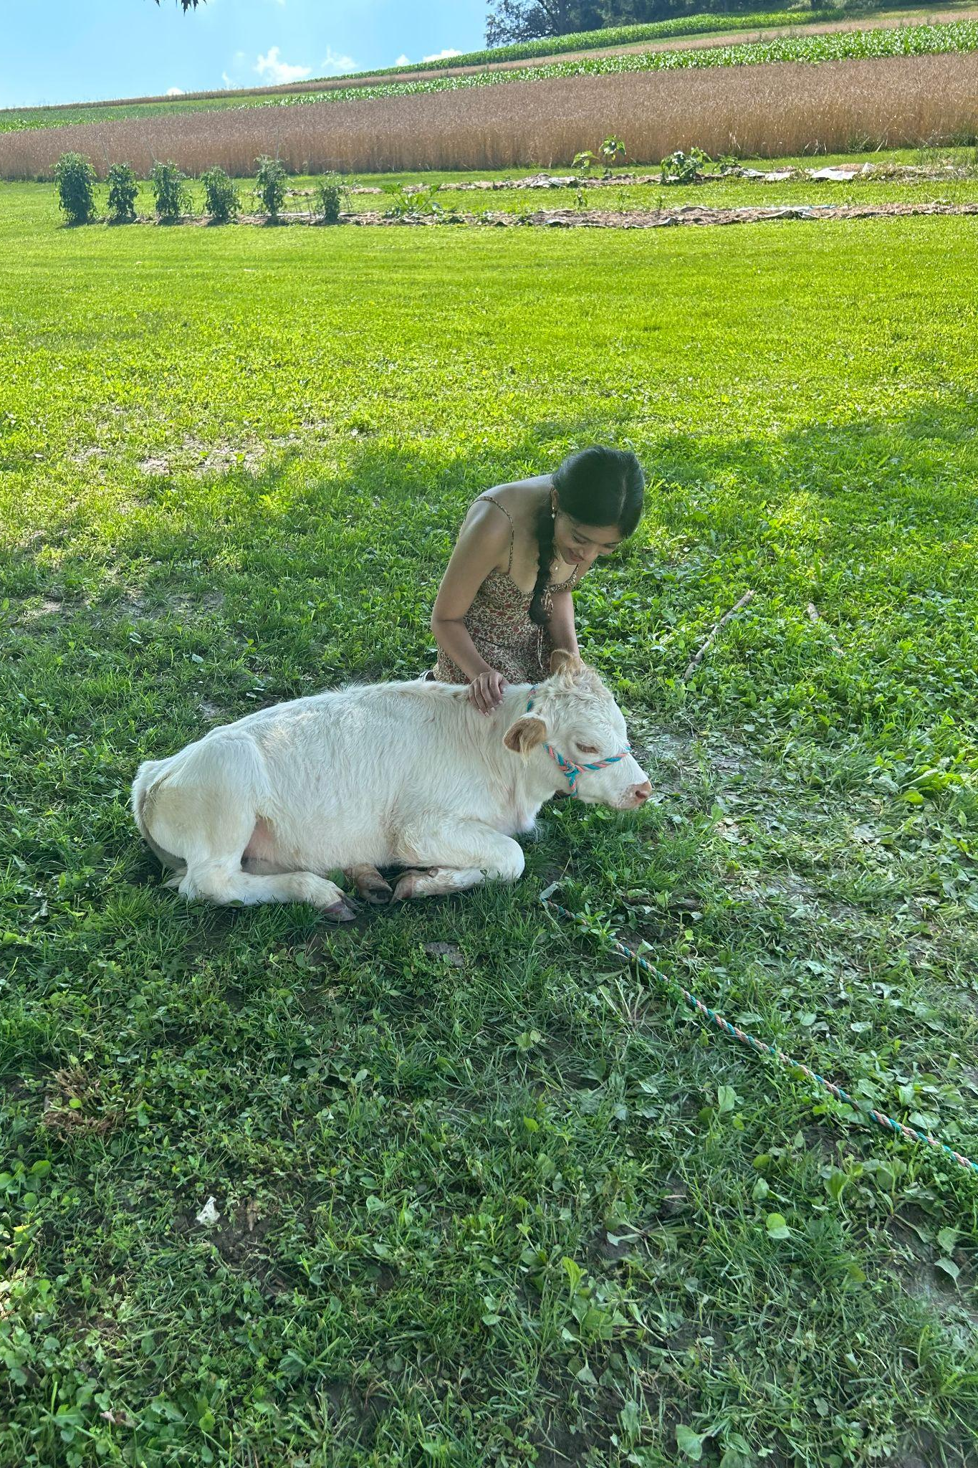
Health Promotion: Nila Chakravarthy - nic156@pitt.edu
Activities for Points (available all semester)
Free group fitness classes through campus rec
  5 pts each, max. 20 pts
  link to register
De-stress activity
  5 pts each, max. 10 pts
  Self-care, movie night, going for a walk, etc.
COVID Boosters
  5 pts
Flu Shot/any vaccine
  5 pts
WELLNESS FAIR: Thursday September 11th, WPU Lawn from 10 am to 2 pm
Help table with NSA (15 points)
Come say hi (5 points)
BLOOD DRIVE (click for donation signup!) : Thursday September 18th, Victoria 1st Floor Lobby from 12:15 to 5 pm! (20 points)
About Me!
Originally from Dallas TX
Work at Children’s in the PICU
Would love to work in Peds or anything with babies

Slide 14
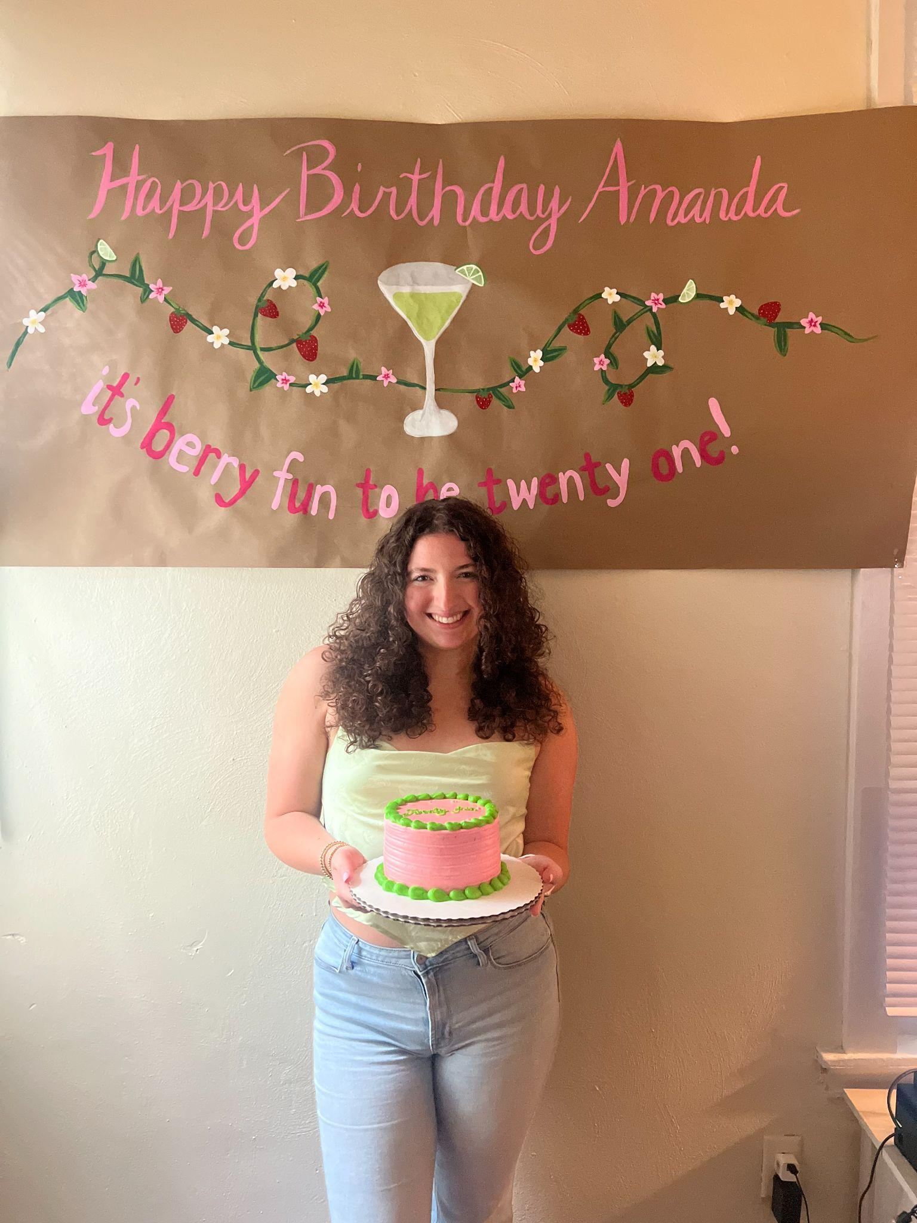
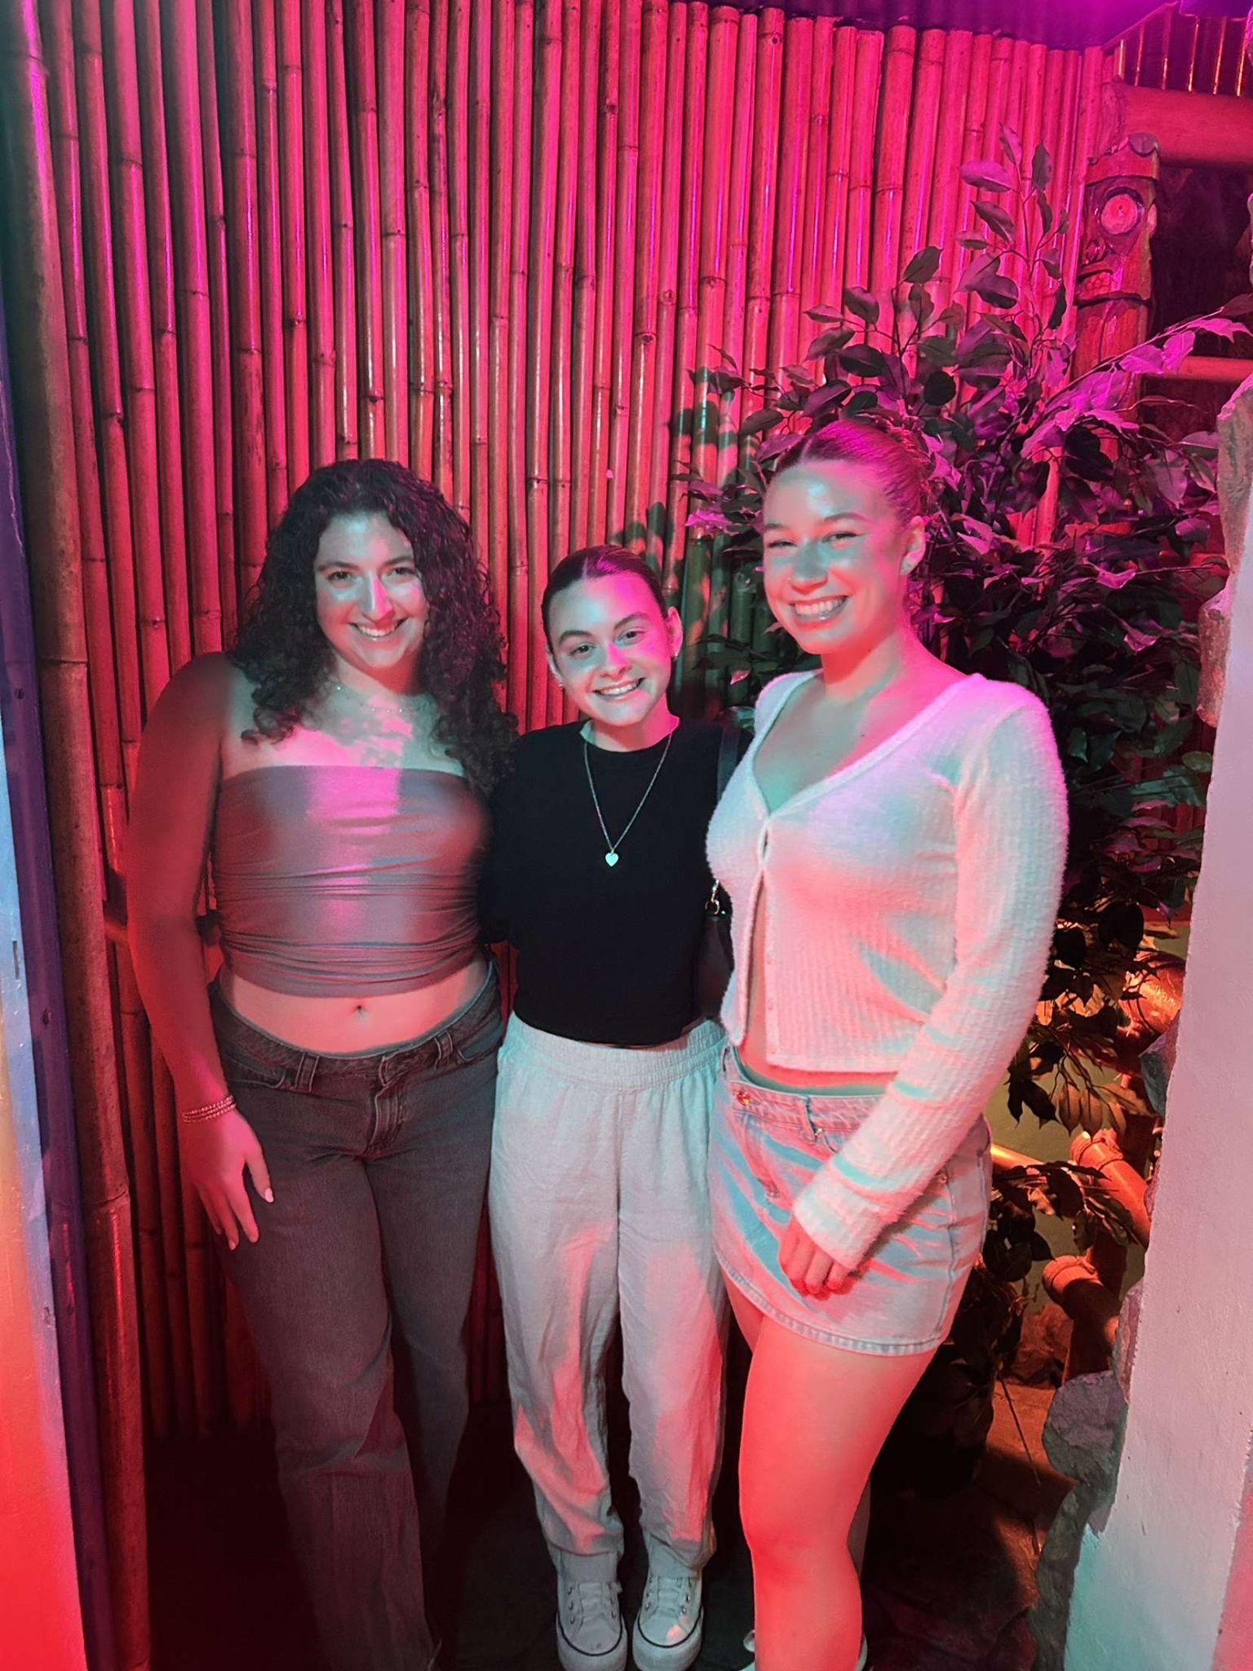


Fundraising: Amanda Theckston - abt60@pitt.edu
Hi everyone!! So excited to see you all!
First Food Fundraiser
Raising Cane’s
9/10 4pm - 9pm
Code: RCFUND96
10 points!!!
Double Good Fundraiser
Online popcorn sale!
We get 50% profit (whaaat?!)
Code: CFDQPA
9/25-9/29
About me
I am from Wilmington, DE
I am a senior :(
I want to be a NICU nurse
I am a PCT on Presby 5G
I am a TA for A&P

Slide 15







Mental Health: Nolan Blaze - nmb163@pitt.edu
Thank you for being here, we are so excited to see all of your new (and returning) faces!!
Time Capsule Letters immediately after GBM (5 pts)
Mental Health Committee Interest Form
Comprehensive Resource List
  Submit a Resource! (5 pts)
Event Interest Form
  PLEASE fill this out so I know what events you are interested in!!
September is National Suicide Prevention Month
  Your life matters
  There is always someone
willing to talk
About me:
Sophomore from Scottdale, PA
I work at Latrobe Hospital as a tech!
Looking to work in peds or child + adolescent psych
Visited 4 countries this summer, was in 2 musicals, and worked as a camp counselor
Stress Relief Tip #1:
Don’t be afraid to ask for help!

Slide 16







DEI: Nathalia Sosa - nas542@pitt.edu
Welcome everyone!! So sad I can’t be here on Mondays but I will be at the Wednesday meetings
DEI Committee
  Click here to sign up
  Help plan fun events and fundraisers
  Have the opportunity to speak about important social issues
DEI feedback form - Here
  Feel free to ask questions and submit suggestions about DEI in NSA and Pitt
Sept 15 - Oct 15 is Hispanic Heritage Month!!
  Latino Community Center will be coming after a GBM to discuss barriers of getting healthcare for immigrants, what to do if someone is uninsured, ICE shows up, etc. (10pts) [10/6 or 10/22]
About me:
I’m a sophomore from Philadelphia, PA
I work at UPMC Magee as a PCT
I wen to Japan, Italy, and France this summer!
Aiming to be a Nurse Anesthetist

Slide 17

Thank you
for coming!

